Slide 1
Plant-Wide Safety Meeting
Agenda
Who’s responsible for your safety?
What’s unsafe in these pictures?
Basic Electrical Safety – Unqualified Team Members
“Safety is more important than a convenience” Steve Ellison, EHS Manager – Two Harbors

Slide 2
Who is responsible for your safety?
You are responsible for your own safety

Slide 3
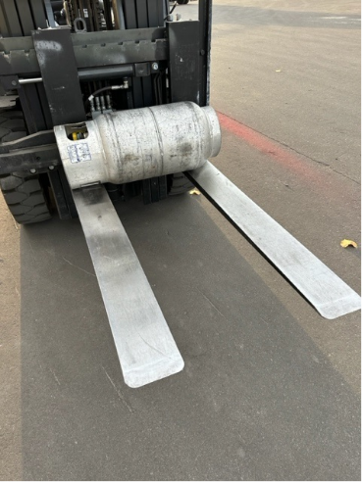
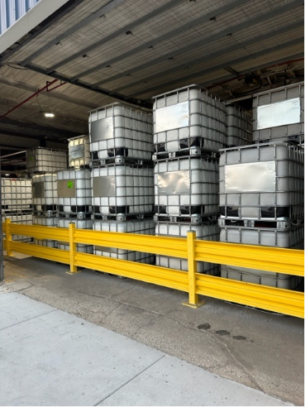
What is unsafe in these pictures?
A
B

Slide 4
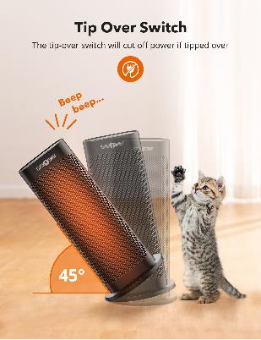
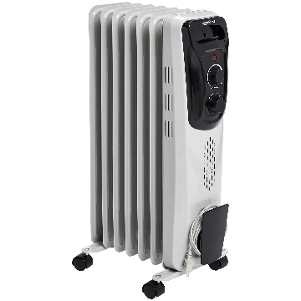
Top 5 – Electrical Fire Causes
Space Heater Safety
Space heaters are a major cause of electrical fires.
Use space heaters with tip over switches
Use radiator type as much as possible
Look at how much electricity is needed.
Notes:
Top 5: Number 4
Space heaters are a major cause of electrical fires. Because these types of heaters are portable, many times people put them too close to combustible surfaces such as clothing, chairs, and rugs. Coil space heaters are especially dangerous. If you do use space heaters, use the radiator-type that diffuse heat over the entire surface of the appliance.

Slide 5
Fundamentals of Electrical Hazards
Have You Ever Been Shocked?
THE BASICS
FOR UNQUALIFIED TEAM MEMBERS

Slide 6
Qualified vs. Unqualified Personnel
For purposes of electrical safety, there
are 2 types of workers: Qualified and Unqualified
A Qualified worker:
Is trained to avoid electrical hazards when working on
or near exposed energized parts
Knowledgeable of the skills and techniques used to
determine nominal voltages of exposed parts/components

Slide 7
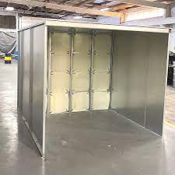
Qualified vs. Unqualified Personnel
An Unqualified worker:
Everyone else (You and Me)
This training is for the UNQUALIFIED TEAM MEMBERS

Slide 8
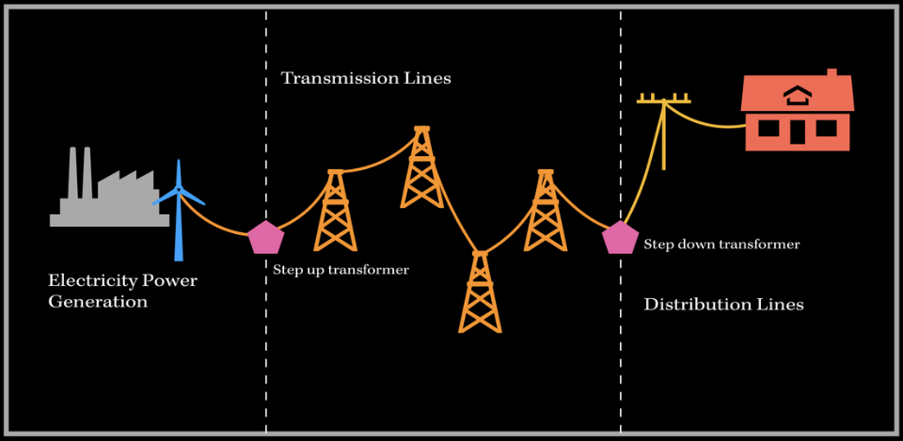
How electricity gets to our home and business
Coal, Water (Hydro), Wind, Solar
Transmission lines are overhead or underground
Metered and monitored into our homes and business
Notes:
To understand how electricity can affect our bodies we must first understand how electricity does its work.
As the diagram shows above, electricity (like water) uses its current flow to perform its work and as it does so its voltage drops from high to low.

Slide 9
Fundamentals of Electrical Hazards
Voltage - electrical pressure
Amperage (“Amp”) - electrical flow rate
Impedance - restriction to electrical flow
Circuit - path of flow of electricity
Fault - current flow through an unintended path

Slide 10
Fundamentals of Electrical Hazards
To flow, electricity must have a complete path.
Electricity flows through conductors.
water, metal, the human body
Insulators are non-conductors.
The human body is a conductor (water in our body)

Slide 11
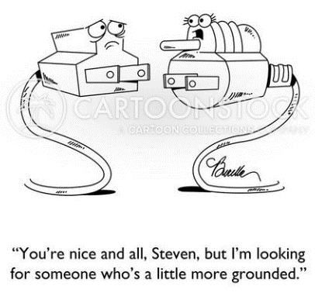
Fundamentals of Electrical Hazards
What is Grounding?
Protection from electric shock
A ground is a conductive connection
between electrical circuit and earth
Do not remove ground pins/prongs from cord- and plug-connected equipment or extension cords.

Slide 12
Electrical Burns
Electrical Burns
Are the most common shock related nonfatal injury
Occur when you touch electrical wiring or equipment that is
improperly used or maintained
Typically occurs on the hands
Notes:
Electrical Burns
Are the most common shock related nonfatal injury
Occur when you touch electrical wiring or equipment that is improperly used or maintained
Typically occurs on the hands
Very serious injury that needs immediate attention

Slide 13
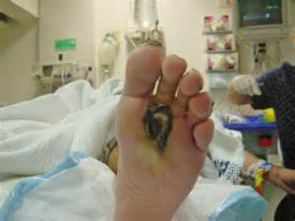
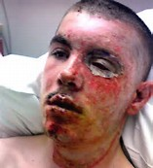
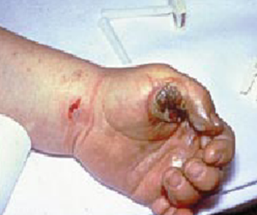
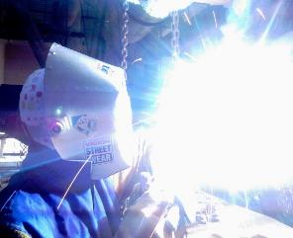
What are the types of injuries?
Burns
Shocks
Arc
Fire & Falls
Explosion

Slide 14
Falls
What are the types of injuries?
Electrical shock can also cause indirect or secondary injuries.
Employees working in an elevated location who experience a shock can fall resulting in serious injury or even death.
Notes:
Falls. When a person is working at an elevated height and receives a shock, there is the likelihood they may fall from their support.
Electrical shock can also cause indirect or secondary injuries.
Employees working in an elevated location who experience a shock can fall resulting in serious injury or even death.

Slide 15
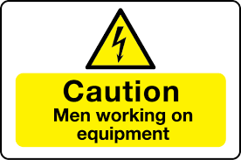
Electrical Protection
Distance
Do not distract or interrupt any Team Member working on electrical items.
If you sense the presence of an electrical hazard keep your distance and STAY AWAY.

Slide 16
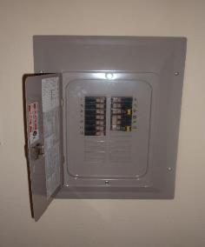
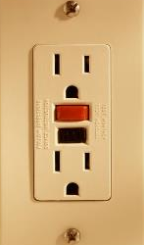
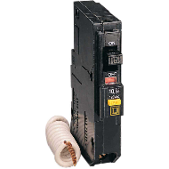
Electrical Protection
Circuit Breakers
Provided to protect EQUIPMENT not people
Do not reset breakers – call your supervisor
GFCI’s
Provided to protect people
Monthly test
Wet environments – bathrooms and kitchens
Some systems have the GFCI in the breaker box

Slide 17
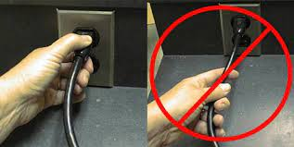
Do’s and Don'ts
Do plug power equipment into wall receptacles with power switches in the off position.
Do unplug electrical equipment by grasping the plug and pulling. Do not pull or jerk the cord to unplug the equipment.
Do not drape power cords over hot pipes, radiators, or sharp objects.

Slide 18
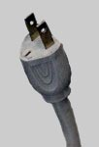
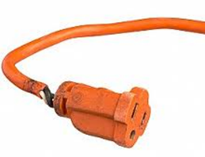
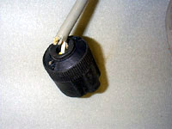
Do’s and Don'ts
Do not plug equipment into defective receptacles.
Do check for frayed, cracked, or exposed wiring on equipment cords.

Slide 19
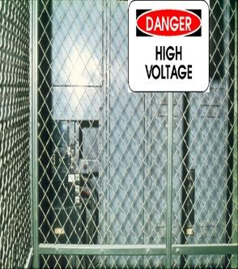
Guarding Live Parts
Keep Out
Must guard “live” parts of electric equipment operating at > 50 volts against accidental contact by:
Mark entrances to guarded locations with conspicuous warning signs
Notes:
The requirement to guard “live” parts of electric equipment operating at > 50 volts against accidental contact can be satisfied by:
Approved cabinets/enclosures or
Location or permanent partitions (thereby being only accessible to qualified persons)
Elevation of 8 feet or more above the floor or working surface to be out of direct or possible accidental contact.
Mark entrances to these guarded locations with conspicuous warning signs.

Slide 20
Guarding Live Parts
Damaged Conduit
Where electrical equipment is in locations that it can suffer physical damage, it must be guarded or moved.
Let your supervisor know if you see damaged conduit.
Notes:
Live Parts are to be guarded!
Where electrical equipment is in locations that it can suffer physical damage it must be guarded.
The violation shown here is physical damage to conduit. It can be imagined that the wires running through this have been placed under strain. Also, the possibility exists that insulation has been compressed to the point of heating, burning through, contacting the metal sleeving. This could be a fire or shock hazard.

Slide 21
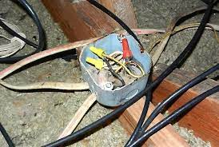
Cabinets, Boxes, Fittings
Junction Boxes
Junction boxes, pull boxes, and fittings must have approved covers.
Unused openings in cabinets, boxes and fittings must be closed (no missing “knockouts”).
If you see this, please let your supervisor know!
Notes:
Cabinets, Boxes, Fittings (29 CFR 1910.305(b))
Junction boxes, pull boxes, and fittings must have approved covers.
Unused openings in cabinets, boxes and fittings must be closed (no missing “knockouts”).
Photo shows violations of these two requirements.

Slide 22
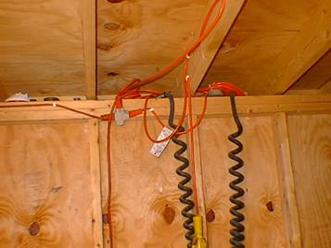
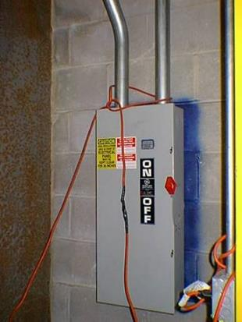
Flexible Cords
Extension Cords Failures
Extension cords shall not be fastened with staples, hung from nails, or suspended by wire.
Notes:
Flexible cords (extension cords)
Extension cords shall not be:
Fastened with staples, (Staples may compress the insulation around the wire. This can lead to heating and deterioration of the insulating wire)
Hung from nails, or (This does not provide a secure attachment and the wire may be subject to movement or strain if not properly secured.)
Suspended by wire. (This places 2 potential conductors within possible contact one with the other-unsafe.)
Strain Relief. Flexible cords shall be connected to devices and fittings so that strain relief is provided which will prevent pull from being directly transmitted to joints or terminal screws. (29 CFR 1926.405(g)(2)(iv).

Slide 23
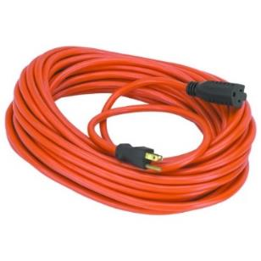
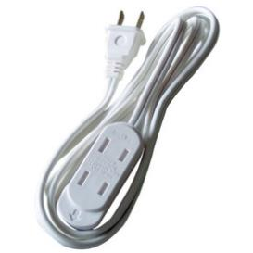
Safety
Extension Cord Safety
Decide whether you will be using the appliance indoors or outdoors.
Extension cords that can be used outdoors will be clearly marked “Suitable for Use with Outdoor Appliances.”
Never use an indoor extension cord outdoors; it could result in an electric shock or fire hazard.
Extension cords should be rated for the appliance or tools being used. Check manual
Notes:
Electrical safety also includes:
Decide whether you will be using the appliance indoors or outdoors. Extension cords that can be used outdoors will be clearly marked “Suitable for Use with Outdoor Appliances.”
Never use an indoor extension cord outdoors; it could result in an electric shock or fire hazard.

Slide 24
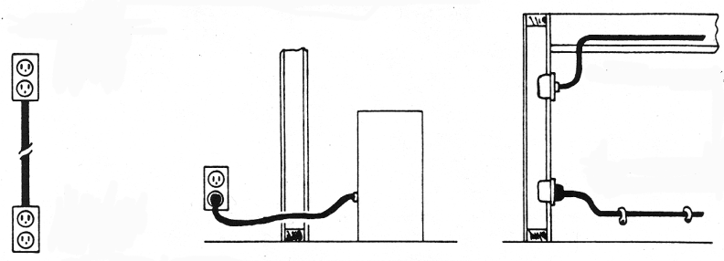
Prohibited Uses of Flexible Cords
Extension Cords
Failures
Examples
Substitute for Run through walls, ceilings Concealed behind
fixed wiring floors, doors, or windows or attached to
building surfaces
Notes:
Prohibited Use of Flexible Cords
These are not a substitute for fixed wiring. (Flex cord may not be up to carry same voltage as fixed arrangement.)
They are not run through walls, ceilings, floor, doors or windows. (Too easy to tamper with or come into contact with.)
They are not concealed behind or attached to building surfaces. (Subject to humidity and dampness changes.)

Slide 25
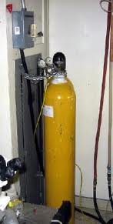
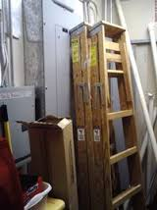
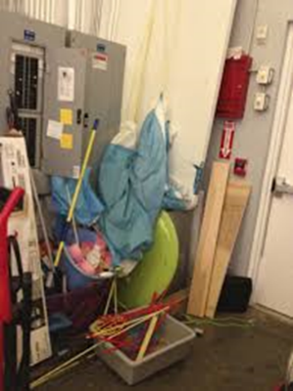
Unsafe
What’s unsafe in these pictures?
C
A
B
Notes:
We do not chain materials to electrical lines; if the material falls it puts a strain on the line or separates the line from its connections.
Ladders against the box contribute combustible materials should there be an electrical fire. Also, this limits access which may be required to shut the system down or isolate breakers (OSHA states there should be at least 3 feet of clearance around an electrical box).
Also, if there is a fault in the electrical box, could the current flow to the outside of the box contacting conductive materials and be a possible shock or electrocution hazard?

Slide 26
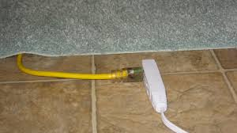
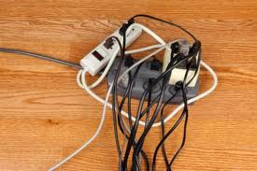
Unsafe
What’s unsafe in these pictures?
Notes:
Left: extension cord under carpet permits foot traffic to compress cord and insulation to the point of thinning and distressing the insulation. Potential fire and shock hazard.
Right: multiple lines into a power strip permits cords to heat up. Fire hazard.

Slide 27
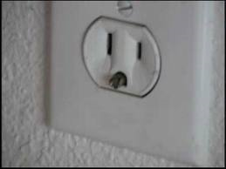
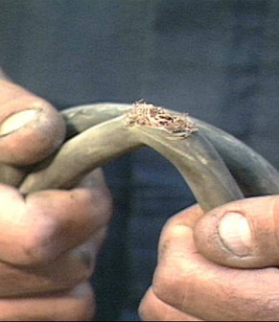
Unsafe
What’s unsafe in these pictures?
Notes:
Left: Grounding prong in receptacle. Seek professional help to remove and replace receptacle.
Right: Damaged insulation and wiring. Destroy and replace.

Slide 28
Questions

