Slide 1
City Of Mount Airy
Asbestos Awareness
J.A. Freeman 2023

Slide 2
Ten Funny Safety Videos – Creative Safety Publishing | Quality Safety Publications, Guides, Posters and Infographics

Slide 3
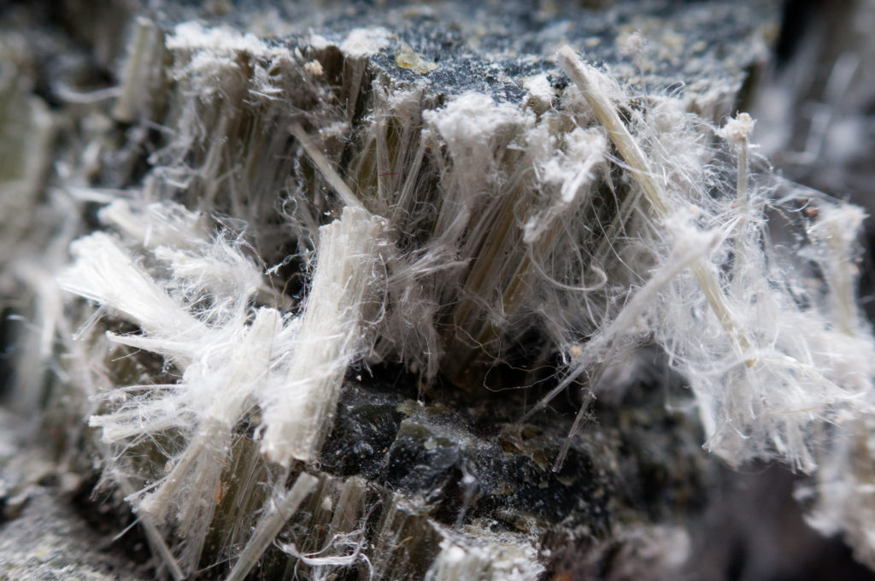
What is Asbestos?

Slide 4
Asbestos is a naturally occurring fibrous silicate mineral. There are six types, all of which are composed of long and thin fibrous crystals, each fibre being composed of many microscopic "fibrils" that can be released into the atmosphere by abrasion and other processes.

Slide 5
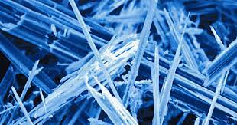
Asbestos
Magnification reveals the sharp needle-like fibrils

Slide 6
Environmental Protection Agency (EPA)
July 12, 1989
Asbestos Ban in the U.S. On July 12, 1989, the U.S. Environmental Protection Agency issued a final rule to ban the majority of asbestos products.

Slide 7
West Side of Main Street – Downtown Mount Airy
The project will include the replacement of the existing water and sewer mains that serve portions of Franklin Street, Oak Street, Virginia Street and Willow Street in Downtown Mount Airy. The lines that serve the area are 70+ years old and are prone to frequent breakages. The planned project will replace outdated and deteriorated water and sewer infrastructure that has caused significant issues for the City.

Slide 8
What’s the Difference?
Each of these substances is composed predominantly of silicon and oxygen; asbestos and silica are crystalline, and asbestos and man-made mineral fibers are fibers. Man-made mineral fibers and asbestos are used as insulating agents, with the former having generally replaced the latter in recent years.
Asbestosis is a chronic fibrotic lung disease that results from the long-term inhalation of respirable asbestos fibers. Silicosis is a respiratory disease caused by inhalation of silica dust that leads to inflammation and then scarring of the lung tissue.

Slide 9
Asbestos Uses:
Fire Retardant panels
Piping (Concrete Filler and Coating agent)
Corrugated Sheeting
Flat sheeting
Mortar and plaster
Vehicles (Clutch, Brake pads and Transmission Parts)
Clothing
Shingles, Ceiling and floor Tiles
Many, Many other Products

Slide 10
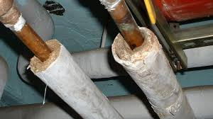
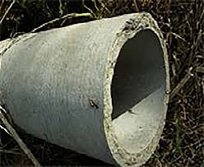
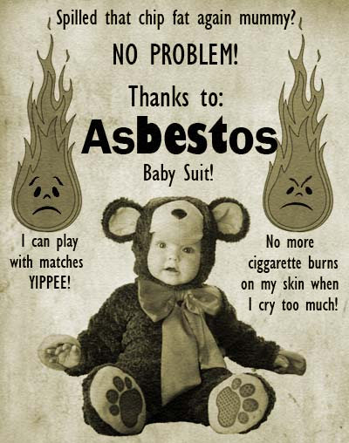
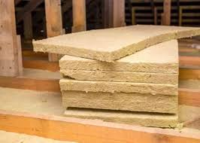
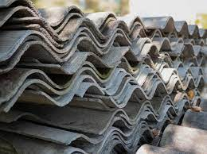

Slide 11
Asbestos in Concrete (AC pipe)
Asbestos fibers added to increase tensile strength and reduce cracking
Fire Resistant (Not much benefit in this aspect)
Longer Life span (Up to 70 years+)
Low cost
Easily Available
Able to mix well with other concrete ingredients

Slide 12
Dangers of Asbestos
Too small to be Seen
Breathing asbestos particles causes asbestosis. (Build up of scar –like tissue)
Pleural Disease- non cancerous lung disease in the lining of the chest cavity
Lung Cancer
Mesothelioma (Fatal malignant tumor in the lining of the lungs or Stomach)
Benign Intestinal Polyps- Usually from ingesting

Slide 13
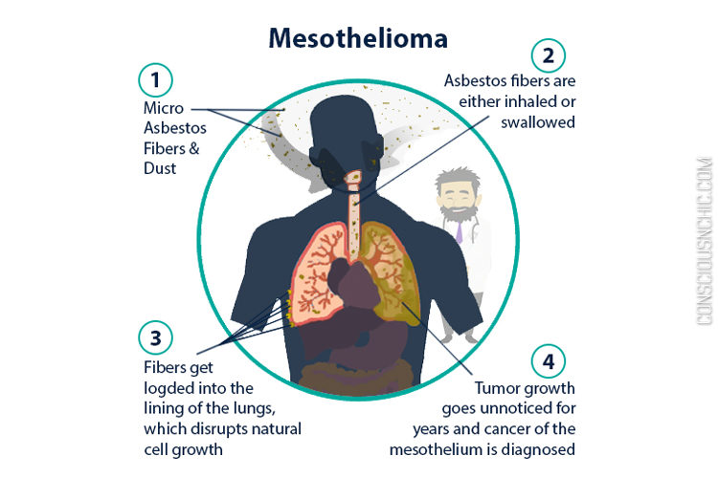

Slide 14

CRF 1910.1001 ASBESTOS

Slide 15
Permissible Exposure Limit (PEL)
Permissible Exposure Limit (PEL) for asbestos is 0.1 fiber per cubic centimeter of air as an eight-hour time-weighted average (TWA), with an excursion limit (EL) of 1.0 asbestos fibers per cubic centimeter over a 30-minute period. The employer must ensure that no one is exposed above these limits. 29CRF1910.1001(c), (1) and (2).

Slide 16
Time Weighted Average
A method of calculating a worker’s daily exposure to a hazardous substance (such as chemicals, dusts, fumes, mists, gases, or vapors) or agent (such as occupational noise), averaged to an 8-hour workday, taking into account the average levels of the substance or agent and the time spent in the area. A time-weighted average is equal to the sum of the portion of each time period (as a decimal, such as 0.25 hour) multiplied by the levels of the substance or agent during the time period divided by the hours in the workday (usually 8 hours). OSHA uses this guideline to determine permissible exposure limits (PELs) and it is essential in assessing a worker’s exposure and determining what protective measures should be taken. Also see permissible exposure limit.

Slide 17
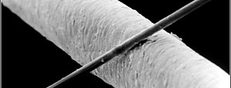
How big is one Micrometer
This is a 6 micrometer diameter carbon filament above a 50 micrometer hair

Slide 18
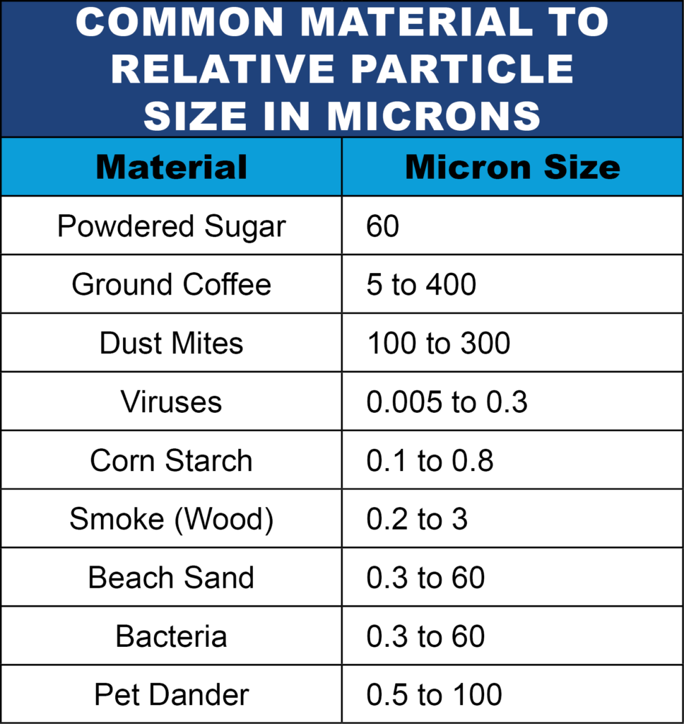

Slide 19
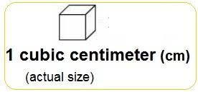
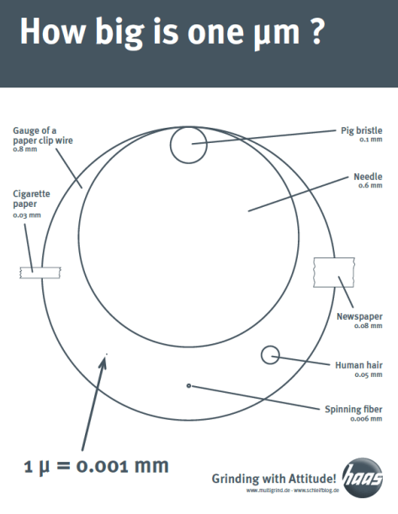

Slide 20
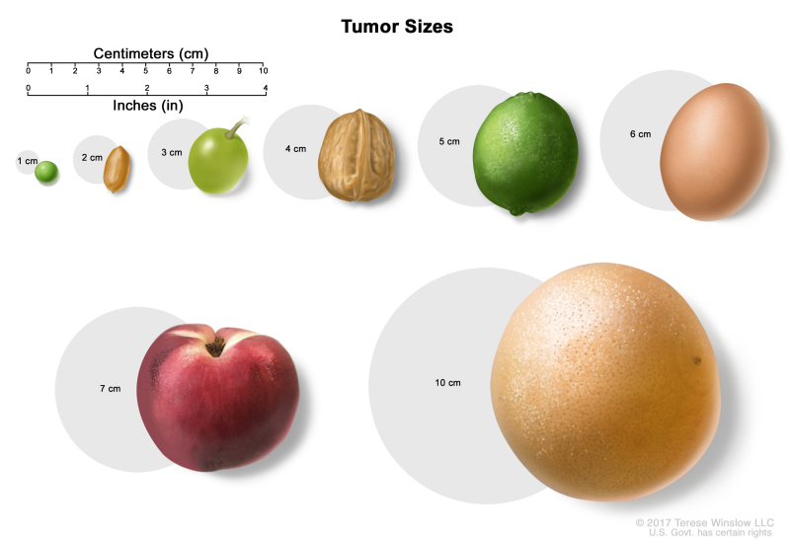

Slide 21
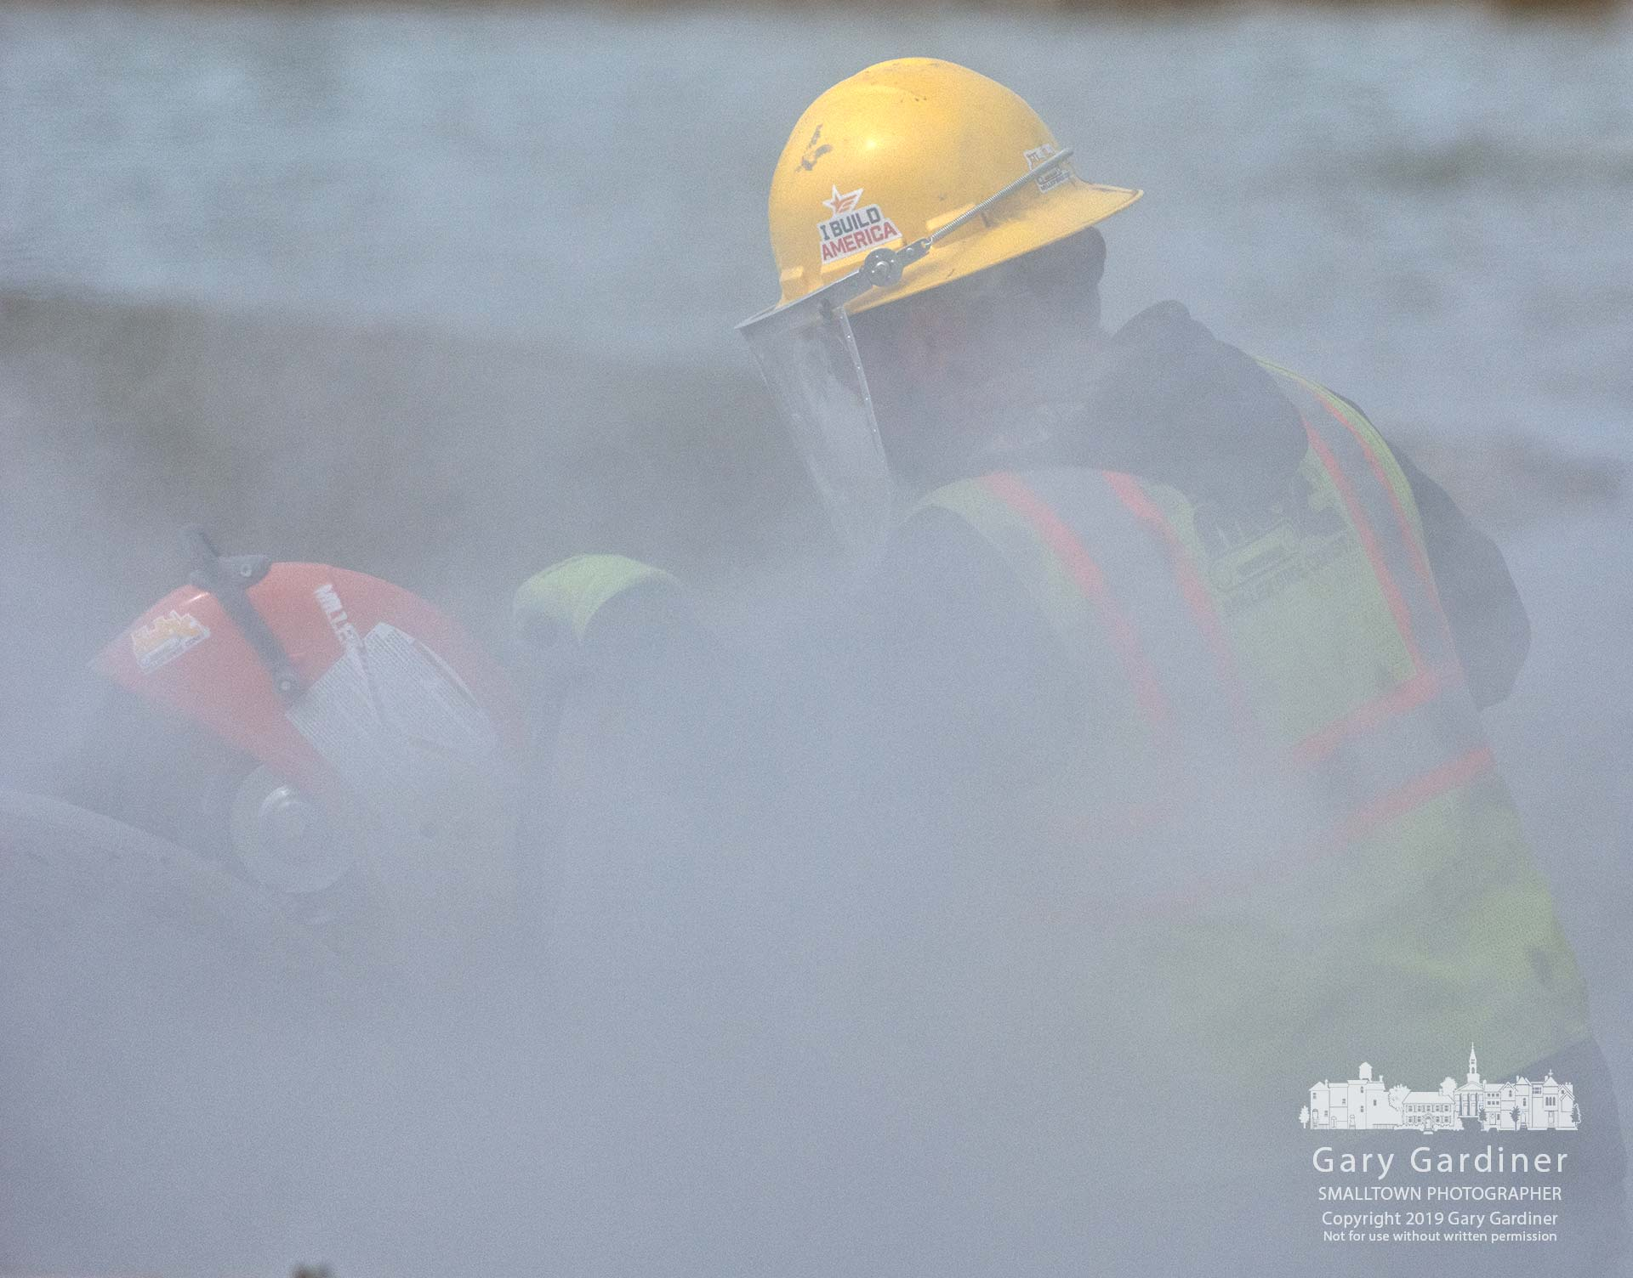
Right or Wrong

Slide 22
Respiratory Protection
Engineer out the danger
Work-Practice Controls (Water, Vacuum, Outsource) (JHA)
PPE (1910.1001(g)(3)(i, ii)
  Respirators, (See CRF 1910.134 (d)(3)(i)(A)) and (CRF 1910.133)
  Eye protection
  Disposable coveralls or similar full-body clothing
(Job Hazard Analysis)

Slide 23
Engineering out the risk
Safety engineering is the process of designing workplaces to prevent accidents. Engineering Safety Concepts provides detailed approaches and modes for accident reduction by using a risk management process to identify and "design out" hazards.

Slide 24
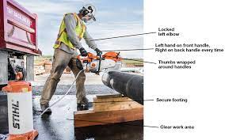
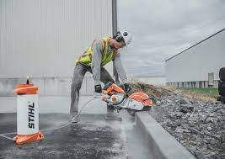
Asbestos and Silica mitigation

Slide 25
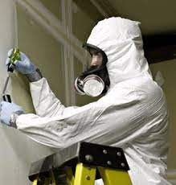

Slide 26
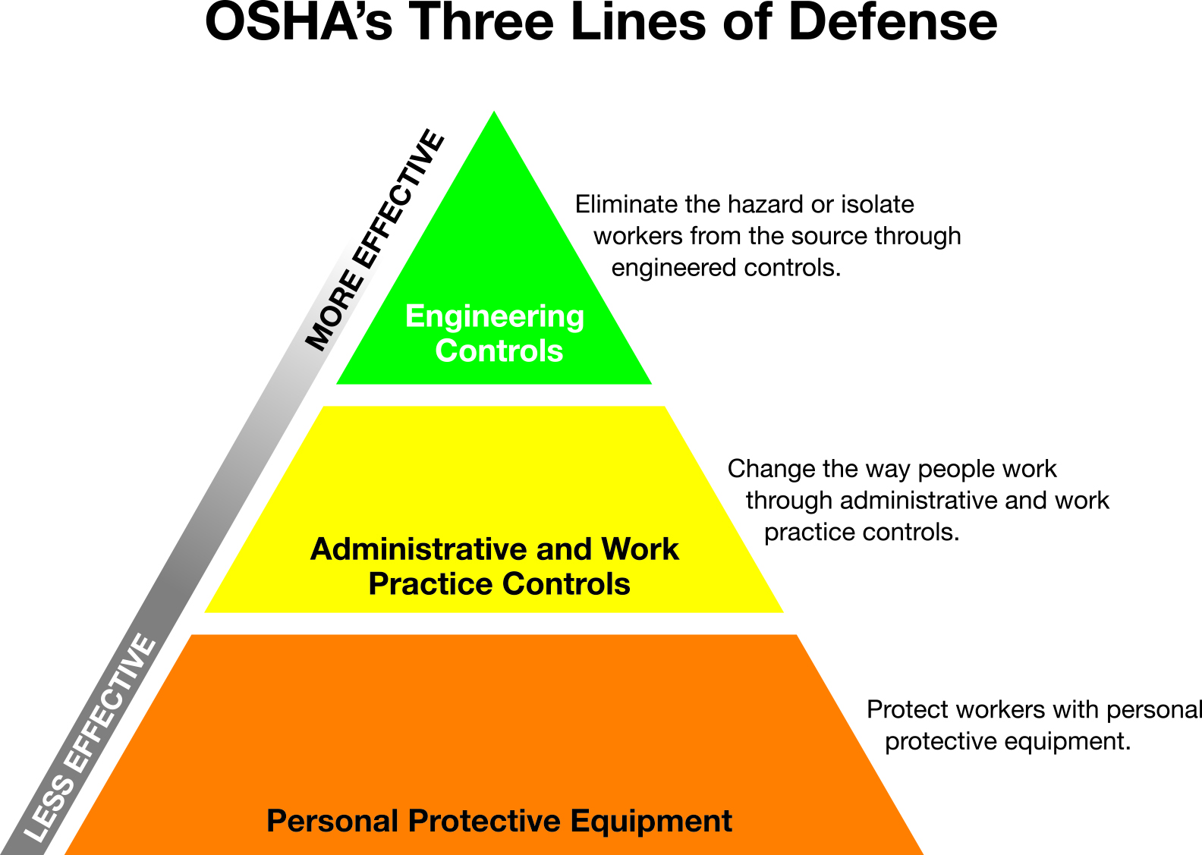

Slide 27
Asbestos fibre Mitigation Continued;
EMPLOYERS MUST:
  Properly dispose of one-use garments. (Seal in impermeable bags/containers)
  Properly clean non disposable garments
  Prohibit the removal of asbestos from protective clothing and equipment using blowing or shaking.
  Follow OHSA Standard number CRF 1910.1001 (Asbestos)

Slide 28
Medical Surveillance
Pre-work, yearly, and post work examinations
Employer SHALL establish and maintain records for each employee subject to medical surveillance under (CRF 1910.1001(L))
Medical Records must be made available to employees
Records maintained for duration of employment PLUS 30 years (CRF1910.1020)

Slide 29
Questions or
Concerns?

