Slide 1
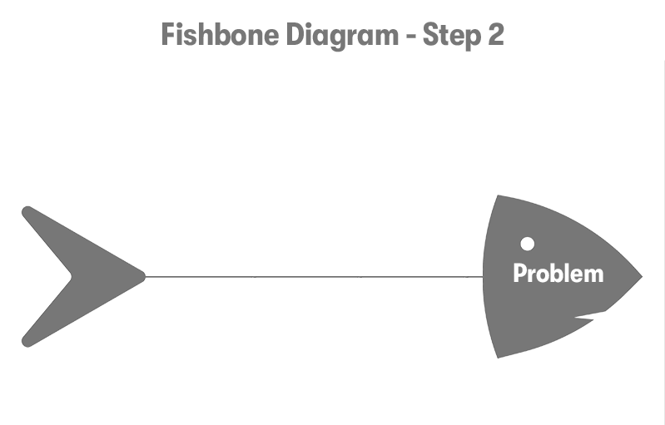

Methods
Machinery
People
Fishbone Diagram
Complex Procedures
Faulty Equipment
Inadequate Training
Poor Housekeeping
Inadequate Maintenance
Protocol Not Followed
Inconsistent Methods
Missing Guards
Poor Communication
Incident
Defective Materials
Lack of Audits
Noise Levels
Improper Storage
Incorrect Data
Temperature
Hazardous Materials
Reporting Errors
Lighting
Materials
Measurement
Environment

Slide 2
Notes:
The Incident, Categories, and Causes are editable for the RCA you are performing.
If more lines are needed, simply copy and paste the lines and the text boxes. You will likely need to shift things to make it fit properly.
The Fishbone Diagram is just a broad example. You will want to be much more specific to your incident. For example, under Machinery – instead of “faulty equipment”, the cause was “damaged lockout point”. This diagram is a broad example, but a real diagram should always be specific to the incident.
More great examples can be found from a simple Google search!

