Slide 1
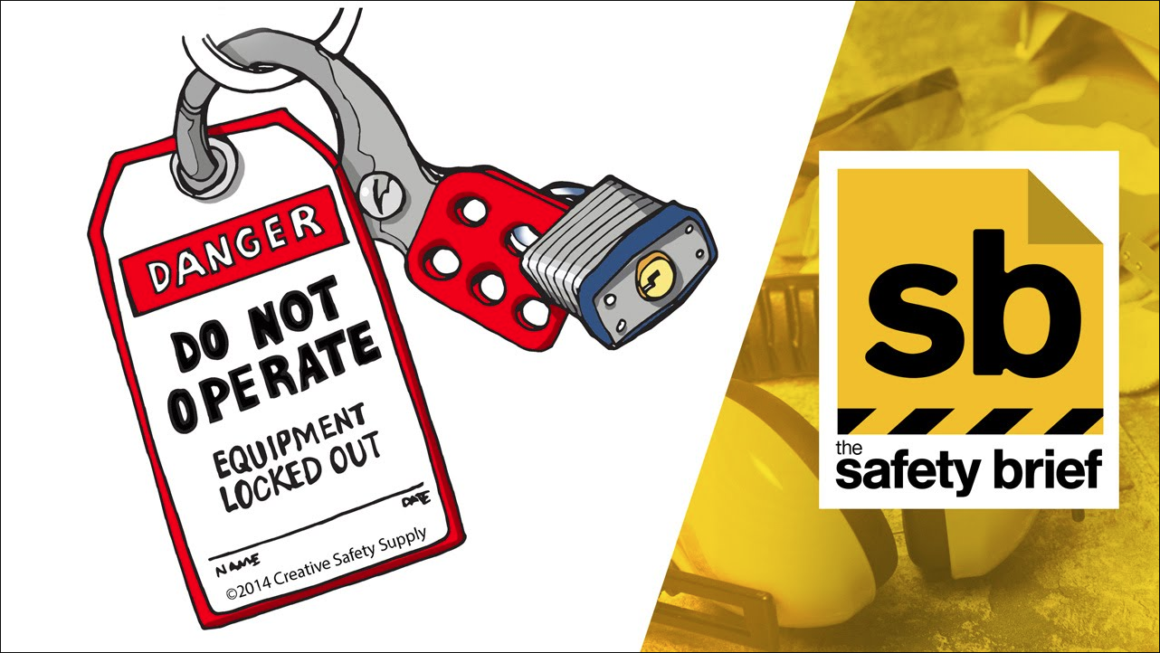


Lockout / Tagout
February Safety Meeting

Slide 2
What is Lockout / Tagout?
Definitions according to the OSHA Standard for the Control of Hazardous Energy, Title 29 Code of Federal Regulations (CFR) Part 1910.147
Lockout is the placement of a lockout device on an energy isolating device, in accordance with an established procedure, ensuring that the energy isolating device and the equipment being controlled cannot be operated until the lockout device is removed.
Tagout is the placement of a tagout device on an energy isolating device, in accordance with an established procedure, to indicate that the energy isolating device and the equipment being controlled may not be operated until the tagout device is removed.

Slide 3
What is Lockout / Tagout?
In other words……
Lockout is de-energizing a machine, and removing the possibility of energy being restored, intentionally or unintentionally, by placing a lock on the energy source.
Tagout is the placement of a tag on a machine, that is also locked out, that indicates that the machine may not be operated.

Slide 4




Types of Hazardous Energy

Slide 5
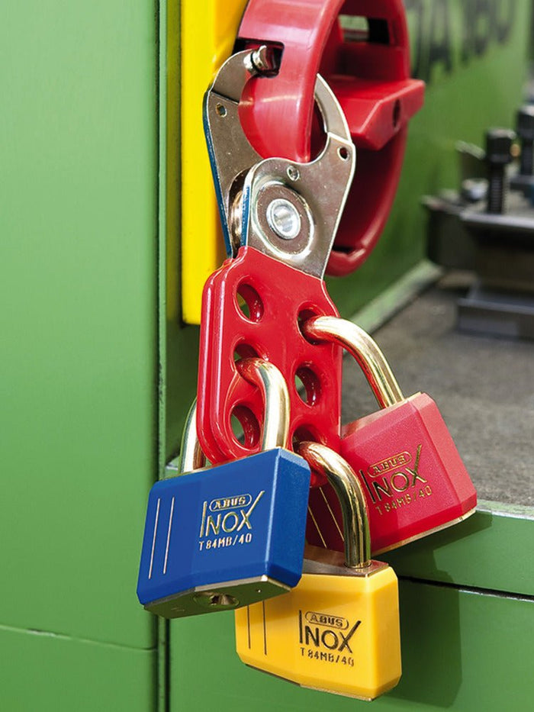
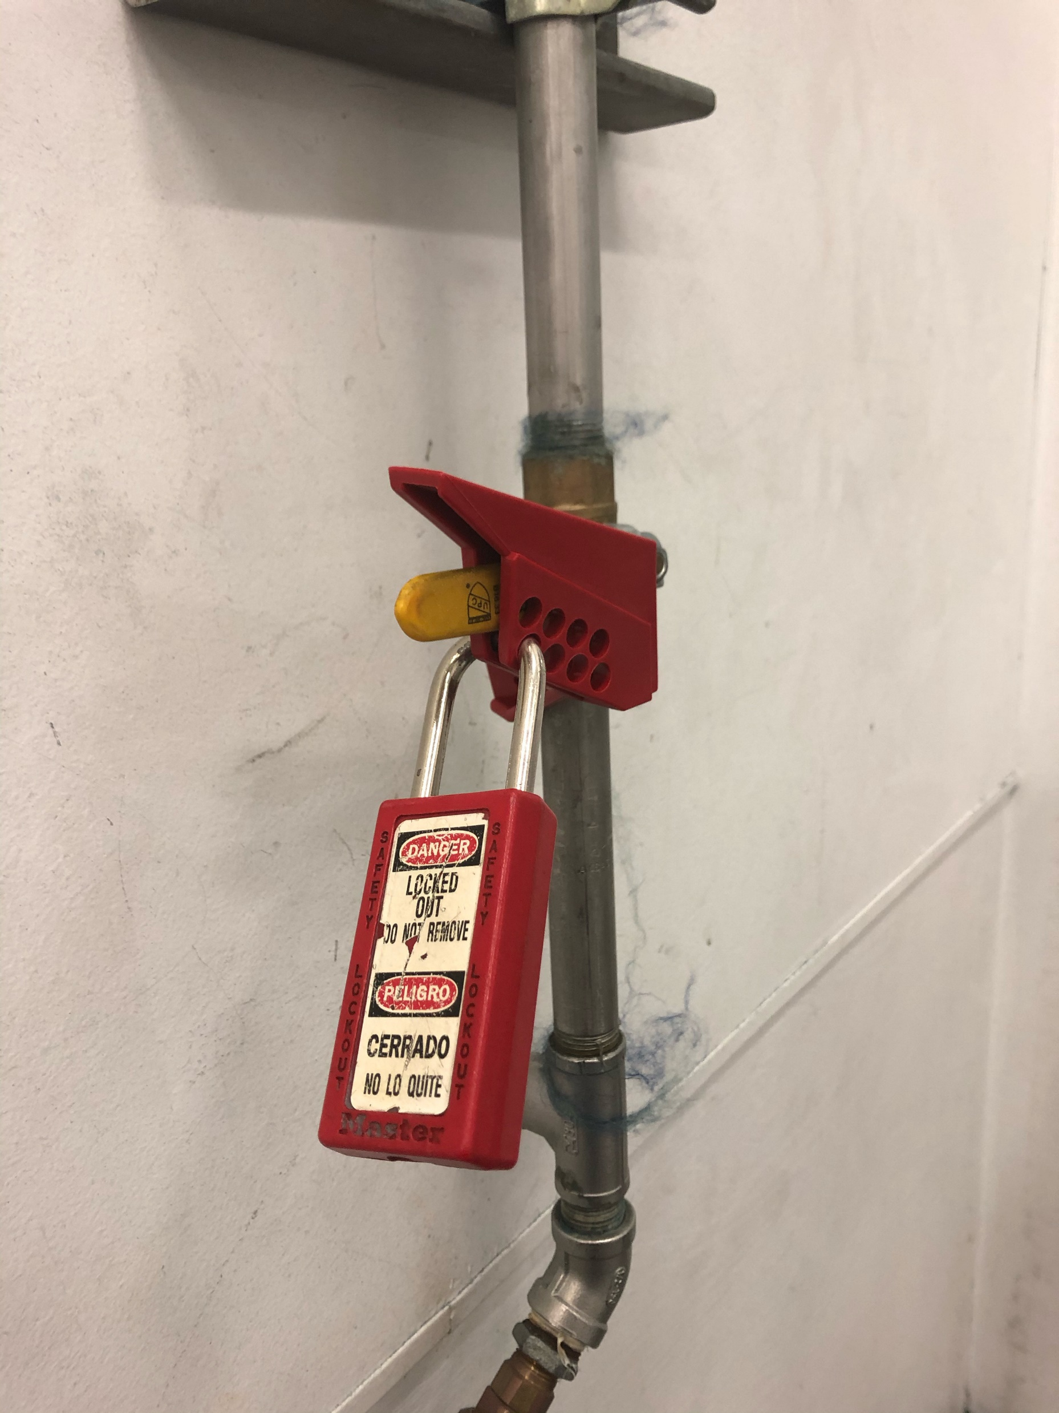
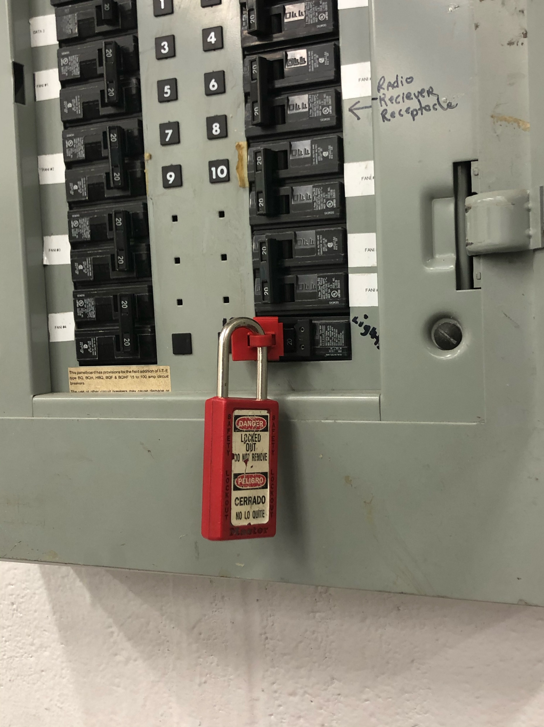
Lockout Devices
Lockout Hasp for Multiple Locks
Pneumatic Lockout Device
Circuit Breaker Lockout Device

Slide 6
Affected Employees vs. Authorized Employees?
Definitions according to the OSHA Standard for the Control of Hazardous Energy, Title 29 Code of Federal Regulations (CFR) Part 1910.147
Affected Person is an employee whose job requires him/her to operate or use a machine or equipment on which servicing or maintenance is being performed under lockout or tagout, or whose job requires him/her to work in an area in which such servicing or maintenance is being performed.
Authorized Person is a person who locks out or tags out machines or equipment in order to perform servicing or maintenance on that machine or equipment. An affected employee becomes an authorized employee when that employee's duties include performing servicing or maintenance.

Slide 7
Affected Employees vs. Authorized Employees?
In other words……
Affected Person is an employee who works in an area or department where lockout procedures are used.
Authorized Person is an employee whose job requires them to perform lockout procedures.

Slide 8
How to Properly Lockout a Machine
Lockout Procedure
NOTIFY all affected associates that the machine will be locked out, and the reason for it.
STOP machine or equipment.
TURN OFF all switches and close off all valves and “bleed down” any stored energy.
LOCKOUT energy sources relevant to the job being performed.
VERIFY that the starting controls will not operate under lockout, and return them to the off or neutral position.

Slide 9
How to Properly Remove Lock & Restore Energy
Removal Procedure
ENSURE all tools, parts, equipment, and trash is clear from around and under the machine.
CHECK to make sure that no one is exposed to any safety hazards resulting from start-up.
REMOVE all locks and tags from lockout devices, and remove lockout devices from machine.
RESTORE energy to the machine, and test run to check function.
NOTIFY all affected associates that the lockout is complete.

Slide 10
When Multiple People Work on a Machine…..
Every person working on the locked out machine, MUST have their lock on the lockout device. No one is allowed to work under another employee’s lock. Doing so will be treated as if you are working on a machine that is not locked out!

Slide 11
Locked Out Machines at Shift Change….
A Shift Leader lock must be placed on the machine BEFORE the last person removes their lock. The key must be given to the Shift Leader. The key will be given to the next shift, and a person’s lock must be placed on the machine BEFORE the Shift Leader lock is removed. This process maintains the integrity of lockout between shift change.

Slide 12
Questions?

