Slide 1
Personal Protective Equipment
City Of Mount Airy

Slide 2
(PPE)

Slide 3
Personnel Affected
These procedures and guidelines apply to all City of Mount Airy employees, full time and part-time, who are at risk to workplace injuries.

Slide 4
PPE Availability
The City will make available for any employee the Personal Protective Equipment required for protection on the job, but not worn off the job site, at no cost to the employee.
Where employees provide their own protective equipment, the Department head shall be responsible to ensure its adequacy, including proper maintenance, and sanitation of such equipment. The basis for determining adequacy will be set forth according to the American National Standards Institute (ANSI) Standards: 29 CFR 1910.132.

Slide 5
Engineering/Admin
Using personal protective equipment is often essential, but it is generally the last line of defense after;
engineering controls, work practices, and administrative controls.
Engineering controls involve physically changing a machine or work environment.
Administrative controls involve changing how or when workers do their jobs, such as scheduling work and rotating workers to reduce exposures.
Work practices involve training workers how to perform tasks in ways that reduce their exposure to workplace hazards

Slide 6
Engineering and Admin Controls
Department Head will implement procedures to eliminate or minimize exposure while maintaining efficiency on the job.
Admin controls include but are not limited to, looking at work schedules, task assignments, and interviews with employees and/or supervisors, in order to reduce or eliminate the potential for harm to employee(s). (JHA)
Department heads will ensure proper PPE is worn. Department Heads will document training and notify the Safety Coordinator of changes that occur regarding the need for additional PPE.

Slide 7
PPE

Slide 8
Employee Training
Initial training sessions for PPE will be conducted at a time specified by the department heads prior to employees being placed in a hazardous situation.\
When the PPE is necessary
What PPE is necessary?
How to properly wear and adjust the PPE.
The proper care and maintenance of the PPE.
The limitations of the PPE.

Slide 9
hazards that will require a worker to wear PPE
Extreme temperatures
Sources of electricity from equipment or machines
Harmful dust
Hazardous chemicals, Biological contaminants
Loud noises
Sharp objects that could cut, stab, or puncture
Areas with the potential of falling or dropping objects
MANY MORE

Slide 10
PPE
Use safety signs, labels, and other forms of communication to remind workers of areas or equipment that require PPE to be worn.
Visual reminders are a great way for employees to remember when the equipment should be worn (like when a machine is turned on) and which type of PPE will be needed.
Reminding employees on the proper use of PPE and equipment will reduce injuries and save lives.
Strict enforcement to PPE rules and procedures is mandatory.

Slide 11
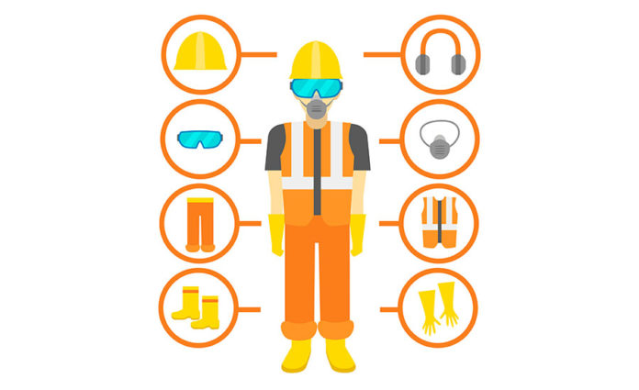
PPE
Additional training sessions will be provided as new PPE is implemented.
The Department Supervisor will maintain a log of training provided.

Slide 12
PPE

Slide 13
PPE

Slide 14
Job Hazard Analysis (JHA)
Job Hazard Analysis (JHA) is a systematic procedure that breaks each job/task into key training sequences, identifies safety elements of each job/task step and coaches the employee on how to avoid potential safety hazards.
Another commonly used term for this process is called a Job Safety Analysis or JSA.
Both a JSA and JHA are considered the same thing.

Slide 15
Hazard Analysis
A hazard assessment should not be a one-time event. Instead, a safety manager or supervisor should conduct these assessments periodically after any changes in equipment, conditions or procedures.
JHA should be reviewed yearly or whenever there is a change in the work process, new task implemented or new PPE equipment is obtained.

Slide 16
Job Hazard Analysis (JHA)

Slide 17
Sub Contractors
Get Proof of Bonding, Licenses, and Insurance.
FOLLOW the COMA CONTRACTOR MANAGEMENT POLICY.
Subcontractor should have a written safety program/policy regarding proper PPE for the job they perform.
STOP and address any unsafe actions if observed.

Slide 18
PPE Inspection
Inspect all PPE before each use and replace as needed.
Supervisors must ensure inspections are being conducted and PPE is being used.
DO NOT SKIMP on PPE when budgeting.
Document, Document, Document

Slide 19
QUESTIONS?

