Slide 1

WEEKLY FOCUS • SPOT THE RISK
High-Potential “Little Things” & Their Impacts
This is a great tool for a “Weekly Focus” or “Spot the Risk” section of your site.
THE LITTLE THING
THE POTENTIAL MAJOR IMPACT
PREVENTION STRATEGY
A slightly frayed extension cord
Arc flash, structural fire, or fatal electrocution.
“Cut it to Save it”: Policy to immediately cut the ends off damaged cords so they cannot be reused; mandatory pre-use inspections.
Storing a heavy box on the top shelf
Traumatic brain injury (TBI) or spinal damage from falling objects.
Red-Line Zone: Paint or tape the top 12 inches of shelving red to indicate “Lightweight/Soft Goods Only.”
A “nuisance” oil drip on the shop floor
Multi-person slip/fall or high-speed forklift skid/collision.
The “Stop & Mop” Rule: Zero-tolerance for standing liquids; provide spill kits at every pillar; root-cause fix for the equipment leak.
Mixing different brands of PPE
Failure of the system (e.g., a face shield that doesn’t “click” perfectly into a hard hat).
Compatibility Audits: Standardize procurement to one manufacturer or verify third-party compatibility certifications.
Using a “cheater bar” for extra leverage
Tool failure/shattering leading to eye loss or severe hand crushing.
The Right Tool Task Force: If workers need a cheater bar, they lack the correct wrench; replace with high-torque or hydraulic tools.
One missing bolt on a guardrail
Systemic failure under weight, leading to a fall from height.
Visual Torque Indicators: Use “torque putty” or paint marks on bolts that crack if the bolt moves, making inspection instant.
A “quick” 30-second entry into a pit
Atmospheric asphyxiation (H2S or O2 deficiency) resulting in death.
Physical Barriers: Lockable covers for any space deeper than 4 feet; “Buddy System” mandatory for even looking into a pit.
Distraction (Checking a text while walking)
Forklift strike or stepping into an active “Red Zone” or “Drop Zone.”
“Hands-Free” Walkways: Designated pedestrian paths where phone use is strictly prohibited while in motion.
An unlabeled “water” bottle
Accidental ingestion of chemicals or caustic cleaning agents.
GHS “Deadly Double” Check: Policy that all secondary containers must have a GHS label, even if they contain water.
Rounding a corner too fast with a cart
Blind-spot collision with a coworker or pedestrian.
Corner Mirrors & Horns: Install convex mirrors and implement a “Stop and Honk” (or shout) protocol for all blind intersections.
SMALL HAZARDS • BIG CONSEQUENCES
1 / 4
Notes:
[Sources]
- Visual on this slide was generated with Microsoft Copilot.
[/Sources]

Slide 2

1 • HUMAN FACTORS
The “Little Things” in Human Factors
These are the invisible “little things”—the internal states that lead to external errors.
THE LITTLE THING
THE POTENTIAL MAJOR IMPACT
PREVENTION STRATEGY
A “Micro-Sleep” (Fatigue)
Loss of vehicle control or machine entanglement.
Fatigue Risk Management: Implement a “No Questions Asked” rest policy for workers who feel unsafe to operate.
The “Hurry-Up” Pressure
Skipping a final safety verification (the “Last Minute Risk Assessment”).
The 30-Second Pause: Mandate a 30-second pause before starting any high-risk task to “reset” the brain.
“Confirmation Bias”
Ignoring a warning light because “it always does that.”
Independent Verification: Have a second person verify critical readings or sensor statuses to break the bias.
Muffled Communication
A misunderstood “Clear!” or “Stop!” leading to early machine startup.
Closed-Loop Communication: Require the listener to repeat the instruction back to the sender before acting.
SMALL HAZARDS • BIG CONSEQUENCES
2 / 4

Slide 3
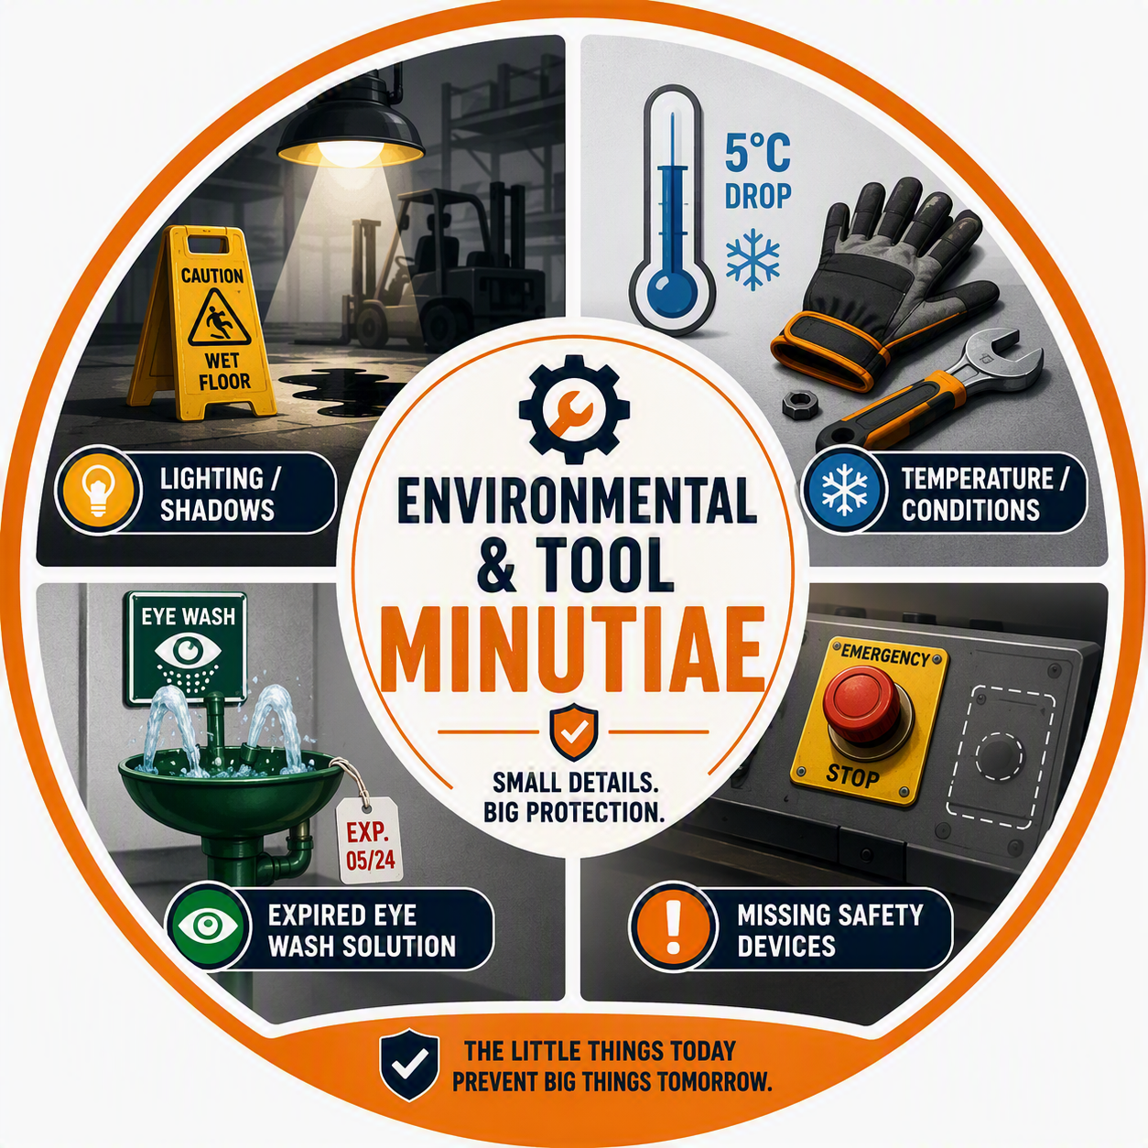
2 • ENVIRONMENTAL & TOOL MINUTIAE
Environmental & Tool Minutiae
These are physical items that are often dismissed as “housekeeping” rather than “life safety.”
THE LITTLE THING
THE POTENTIAL MAJOR IMPACT
PREVENTION STRATEGY
A Missing “Dead Man’s Switch”
Uncontrolled machinery if the operator becomes incapacitated.
Interlock Audits: Weekly functional testing of all emergency stops and presence-sensing devices.
A 5° Temperature Drop
Reduced manual dexterity leading to dropped tools or fumbled controls.
Thermal Comfort Zones: Provide hand-warmers and mandated “warm-up” breaks in cold-weather outdoor work.
Expired Eye Wash Solution
Permanent eye damage or infection during a chemical emergency.
Digital Tracking: Use QR codes on all safety stations for instant logging of expiration dates and inspections.
Shadows/Poor Lighting
Hidden trip hazards or inability to see a moving forklift mast.
Lux Level Mapping: Conduct a lighting survey during night shifts to identify “dark spots” in high-traffic areas.
SMALL HAZARDS • BIG CONSEQUENCES
3 / 4

Slide 4
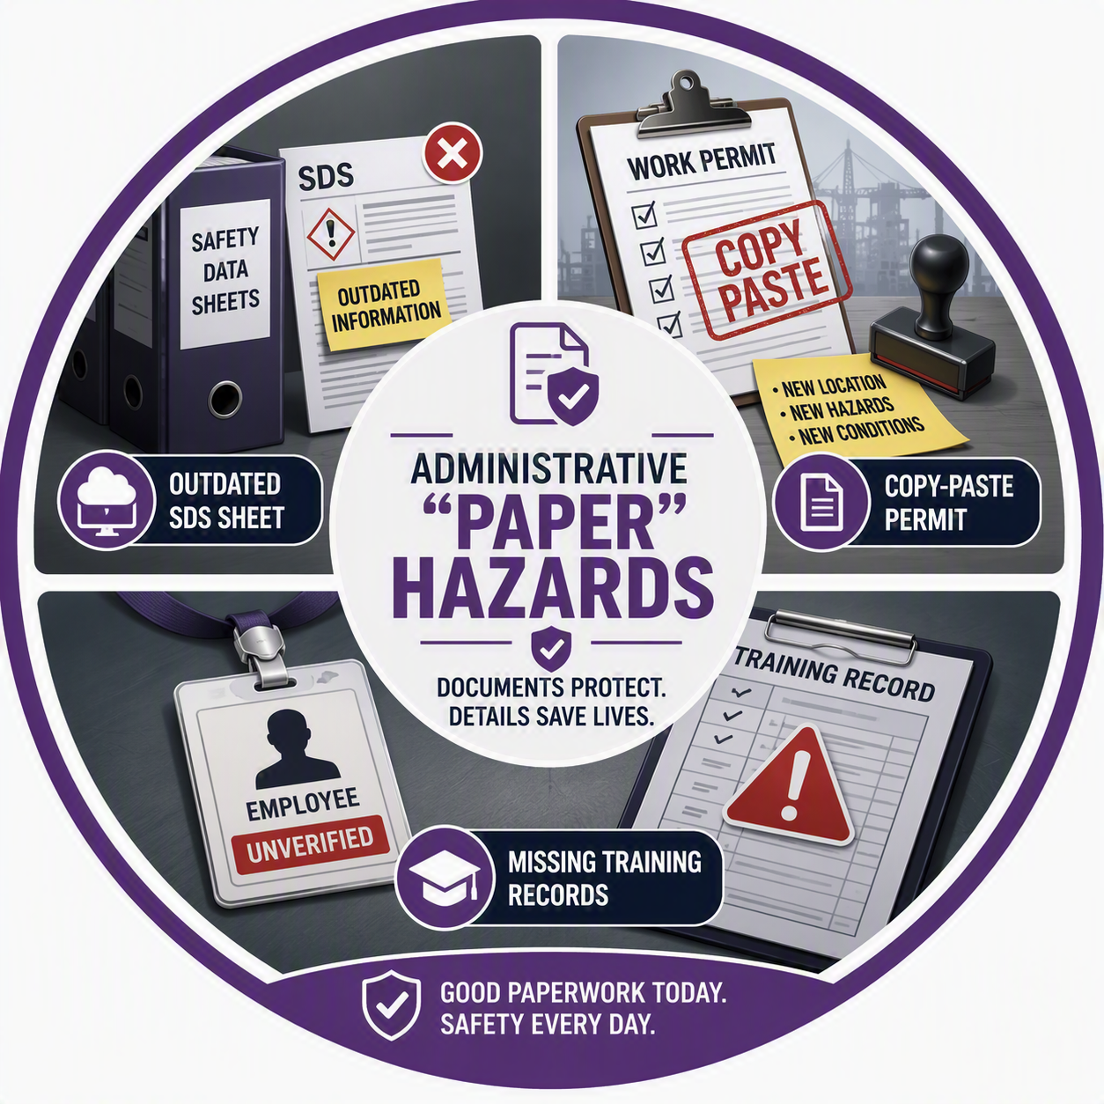
3 • ADMINISTRATIVE “PAPER” HAZARDS
Administrative “Paper” Hazards
Small errors in documentation that lead to physical catastrophes.
THE LITTLE THING
THE POTENTIAL MAJOR IMPACT
PREVENTION STRATEGY
An Outdated SDS Sheet
First responders using the wrong neutralizing agent for a chemical spill.
SDS Digital Access: Move from physical binders to a cloud-based system accessible via mobile devices on the floor.
A “Copy-Paste” Permit
Overlooking a new hazard unique to today’s specific job site.
Blank-Slate Permitting: Prohibit “re-using” permits; require workers to walk the site before signing.
Missing Training Records
An unqualified worker operating specialized equipment (e.g., an overhead crane).
Badge Integration: Link equipment ignition or access to training databases (if trained, the machine starts).
SMALL HAZARDS • BIG CONSEQUENCES
4 / 4

