Slide 1
Plantwide Safety Meeting – Bloodborne Pathogens (BBP) Training
June 2024

Slide 2
Training Agenda
What’s right (or wrong) with this picture?
PPE – our last line of defense
Bloodborne Pathogens (BBP)
Quiz

Slide 3
What is unsafe in this picture?

Slide 4
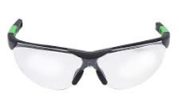
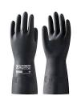
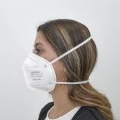
PPE – The last line of defense to keep you safe
1.
2.
3.
Hearing protection – plugs or muffs
4.
5.
6.
Gloves to handle product, paint, propane
Voluntary Respiratory Program
High Visibility Tops

Slide 5
Bloodborne Pathogens

Slide 6
Bloodborne Pathogens Training Objectives
Definitions
The diseases these pathogens can cause
Risky situations - at work and in the community
How to protect yourself
Question & Answer

Slide 7
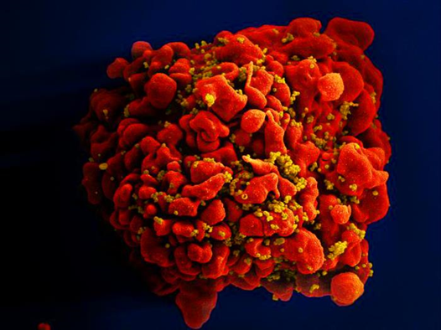
What Are Bloodborne Pathogens?
Pathogen: a germ, a virus, or bacteria - something that can make you sick
Bloodborne: Carry or transmit in human blood
So, a bloodborne pathogen (BBP) is something that can make you sick, that can be carried in human blood (and a few other body fluids) - but transmission of illness can only occur if you come into contact with it in certain ways

Slide 8
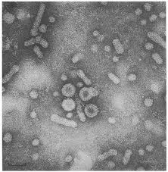
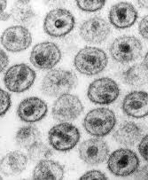
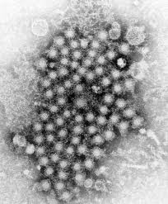
Three Most Common Bloodborne Diseases
HIV: Human Immunodeficiency Virus
Can lead to Acquired Immunodeficiency Syndrome (AIDS)
HBV: Hepatitis B Virus
HCV: Hepatitis C Virus
HIV HEP B HEP C

Slide 9
Other Potentially Infectious Materials (OPIM)
BESIDES BLOOD, THESE BODY FLUIDS CAN TRANSMIT BBP:
Body fluids surrounding the brain, spine, heart, lungs, abdomen, joints
Any fluid contaminated with blood
All body fluids in situations where it is difficult or impossible to differentiate between body fluids

Slide 10
Other Potentially Infectious Materials (OPIM)
BODY FLUIDS THAT DO NOT TRANSMIT BBP, UNLESS VISIBLY CONTAMINATED WITH BLOOD:
Saliva (unless dental procedures involved)
Urine or feces
Vomit
Sweat or tears

Slide 11
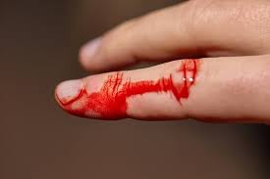
3 Examples of “Certain Ways” Bloodborne Pathogens Can Enter Your Body
1. Contact with non-intact skin: example: A first aid provider helps an injured worker, but wears no protective equipment, and the provider has a cut, scratch, or sore on their hands
Should you wear a glove to help this person?

Slide 12
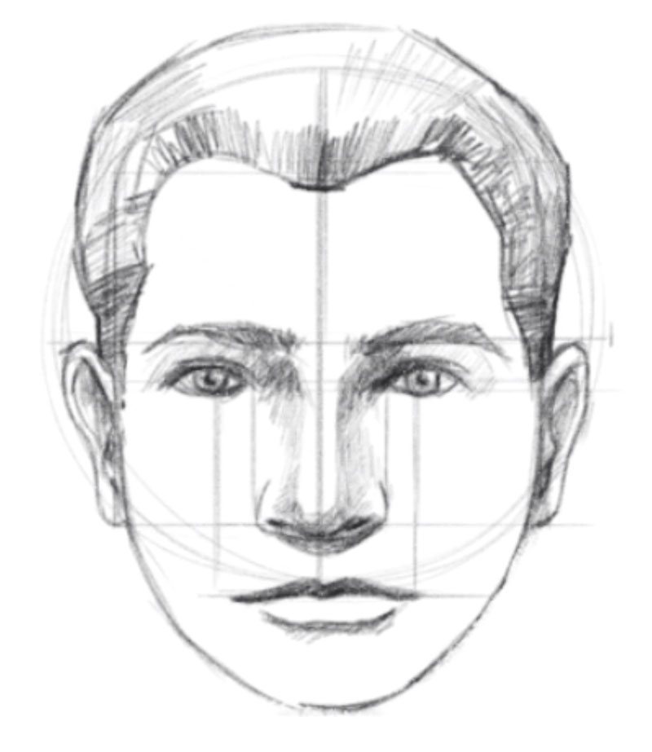
3 Examples of “Certain Ways” Bloodborne Pathogens Can Enter Your Body
2. Through mucous membranes: eyes, nose and mouth; example: a blood splash, or accidental secondary contact between contaminated gloved hands and face

Slide 13
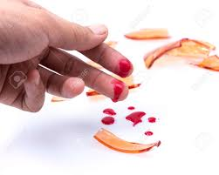
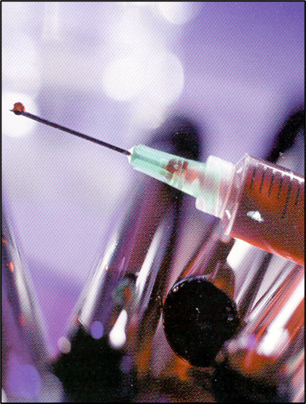
3 Examples of “Certain Ways” Bloodborne Pathogens Can Enter Your Body
3. Through a wound from a contaminated sharp object; example: a dirty needle or broken glass

Slide 14
Risky Situations on the Job
First Aid / CPR Responders
Maintenance Technicians

Slide 15
Risky Situations in Your Community
Unprotected sexual contact with an infected partner
Sharing drug, tattoo, or piercing needles
Sharing personal items such as razors or toothbrushes (may have blood on them)

Slide 16
SIGNS & SYMPTOMS
HEPATITIS B:
About 30% of persons have none.
Signs and symptoms are less common in children than adults. They can include: jaundice, fatigue, abdominal pain, loss of appetite nausea, vomiting, joint pain.
HIV:
Can include depression, diarrhea, nausea / vomiting, unexplained weight loss, fatigue, night sweats, sinus infections, and tingling / burning of the hands and feet.
HEPATITIS C:
80% of persons have none.
Signs and symptoms can include: jaundice, fatigue, dark urine, abdominal pain, loss of appetite, nausea.

Slide 17
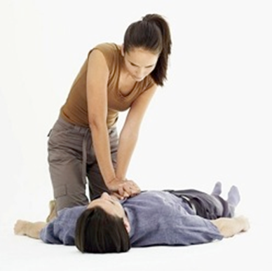
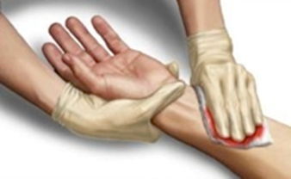
How Can You Protect Yourself?
Universal Precautions (Be Careful All The Time)
Assume all blood and body fluids are infected
No matter if you are cleaning up or treating an injury, use Universal Precautions to protect yourself BEFORE you start

Slide 18
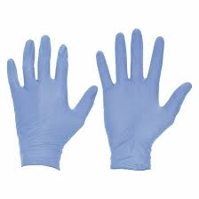
PPE – Personal Protective Equipment
Single-use gloves – nitrile

Slide 19
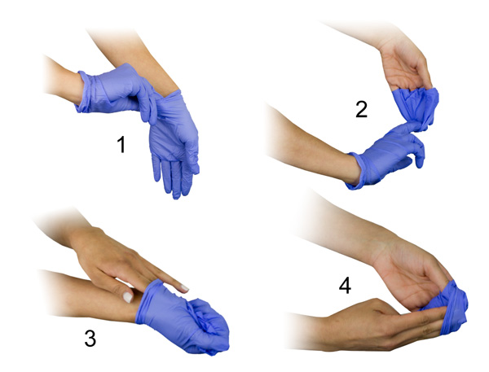
Proper Glove Removal Keeps You Safe

Slide 20
Removing PPE
Properly dispose of single-use gloves (trash is acceptable)
Turn items inside out
Wash hands thoroughly with warm water and soap
Wash contaminated clothing

Slide 21
Cleaning Up Blood or Body Fluids
Wear PPE
Use a 1:10 bleach and water solution or disinfectant to clean anything that has been contaminated
Use tongs, brush, and dust-pan to pick up broken glass – not your hands!
Place in a trash bag then tie it and throw in trash outside

Slide 22
Exposure Control Plan

Slide 23
Exposure Control Plan
Who is at risk
Control methods – universal precautions, handwashing, PPE
Post-exposure evaluation – (if you are exposed to blood while at work) reporting, Hep B vaccine offering, immediate treatment, follow-up
Training
Recordkeeping

Slide 24
Questions?

