Slide 1
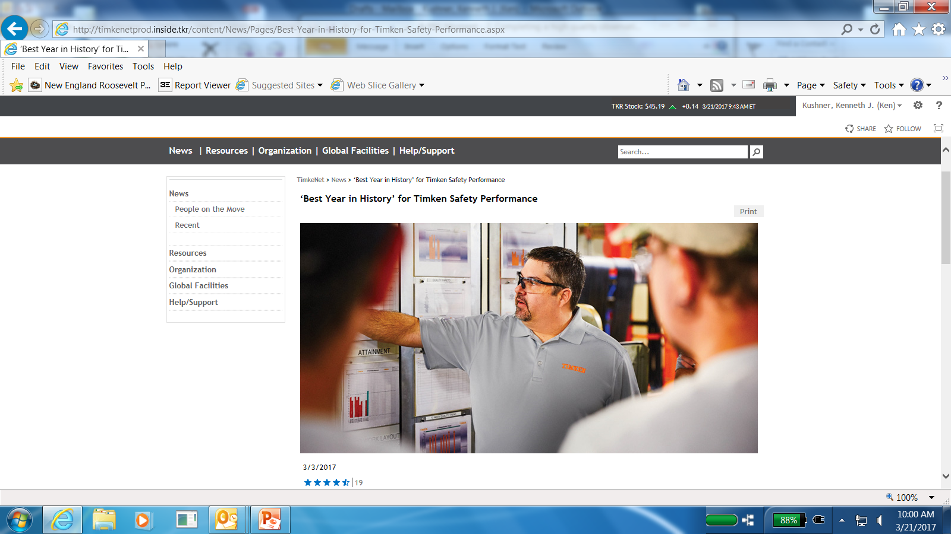
How to Complete a
High Quality PBS
Observation

Slide 2
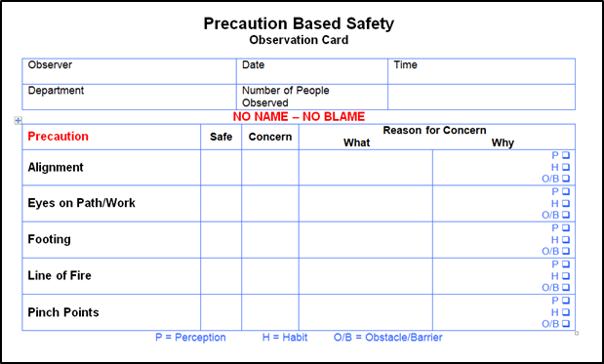
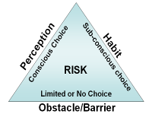


PBS Process Overview
PBS SME
Site Manager
Identify Precautions
Select, train and coach observer
STEERING TEAM
Recommend tactics & strategies to Site Manager and Leadership team to drive improvements in behavior.
Analyze & communicate
I’m Concerned, WHY do you do it this way?
Thank you for taking Precautions
I don’t think it is heavy!
There is no other way to do it!
I always do it like this!
Observer
Enter observations into ProAct Data Base
Notes:
The process centers around the worker. If workers are already trying to be safe and using the traditional safety programs, common sense, and experience, how can we help them be even safer?
A Steering Team with representatives from each major area of the organization. We teach this team the basics of PBS and then ask them to study the accident data and form a checklist of the most important behaviors to improve safety.
This checklist helps to focus the workers on the most important safety behaviors and to think one step ahead of accidents.
This focus is reinforced through observations which give positive reinforcement and express concern while asking why risks are being taken.
This data is entered into a computer where it can be analyzed and reported in a way that helps the steering team.
The steering team uses this data to formulate action plans to help workers to stay focused and remove the obstacles and barriers that make it difficult or impossible to do jobs safely.

Slide 3
The AWARE Process
Announce – make everyone aware
Watch – observe for the checklist items
Ask – why do you do it that way?
Reinforce – the things workers do safely
Express Concern – the accident potential

Slide 4
Announce
Make sure everyone you will observe is aware of the observation before you begin
Develop informal ways to announce observations (hard hats, vests, checklists)
Guidelines:
  Be courteous and show respect
  Answer questions and address concerns
Notes:
The first step in the observation process is to let the person you intend to observe know that you are there.
Keep in mind that this initial contact with the person to be observed will set the tone for the entire observation. Be respectful and courteous of the employee and answer any questions or concerns that they may have about your process.

Slide 5
Watch
Become familiar with the site checklist
Look for the checklist items that apply (<5 minutes)
Fill in the top blanks completely
Mark only the “Safes” or “Concerns” that you see.
  If you do not see a behavior - don’t mark it
Put all reasons for concern next to precaution
Basic Knowledge section of checklist
All additional comments at bottom or back
Notes:
After you have made the worker aware that you are there, you should spend the next few minutes just watching the job task.
During this part of the observation, you are looking for the pinpointed precautions that are on your checklist. It is helpful if you are familiar with the checklist so that you spend the time observing the worker and not your checklist.
Prior to the observation or at some point after, you should ensure that all of the variable are completely filled out on the top of the observation checklist. These are the variables that the steering team will use to determine how to better improve the actions plans and the observation strategy for your site.
Remember that these precautions are very specific and focused based on the pareto analysis that was done using your site specific data. You are looking for these specifically. Mark “safe” or “concern” next to any precaution that you observe during your observation time. These should be marked in the row associated with the precaution that you observed.
For each “concern” marked you should also note “What” you observed and then note the reason the worker gives you as to “Why” they did not take the precaution on the checklist.
The Basic Knowledge section of the checklist is designed to measure how well the workforce has internalized the precautions that are being focused on for the site. The observer should ask the worker to name as many of the precautions on the checklist, without looking of course. Circle the total number that the worker could name from memory on the checklist and
Any additional comments associated with anything other than the precautions on the list should be marked in the additional comments section on the checklist.

Slide 6
Ask
When you are concerned about a behavior or the lack of it, ask the most appropriate question:
  Why did you do it that way?
  Is that the way you always do it?
  Do you feel safe doing it that way?
  Do you know a safer way to do it?
  Were you trained to do it that way?
Notes:
If you are uncomfortable asking “why?”, try some of these alternatives to start a conversation about the reasons why risks are being taken.

Slide 7
Reinforce
Point out what is being done safely
Encourage workers to continue
Stick to the facts! No opinions or evaluations.
Be positive
Show respect
Set a good example
Notes:
Observations are an opportunity to point out the positive things that a person is doing for safety. Emphasis should be placed on reinforcing what the worker is doing right to ensure that they are not just being lucky when it comes to accident prevention.

Slide 8
Express Concern
Set the right tone
Care! Don’t Criticize!
Be specific
Keep on the subject of safety
All concerns are possible accidents
Maintain respect
Notes:
Expressing concern to a fellow worker about a safety issue is largely an issue of setting the right tone and convincing them that you are there to care rather than to criticize.
It helps to keep on the subject of safety and connect your concerns to possible accidents and to maintain a tone of respect for the worker.

Slide 9
NOT an Observer’s Job
Ambush or spy on workers
Catch people doing it unsafely
Criticize worker performance
Be the safety cops
(risks vs. rules)
Watch a whole task or job
Force people to change
Turn people in for discipline
Identify conditions that don’t directly impact critical behaviors
Notes:
(you may want to modify these items if some don’t apply or other issues impact your site)
It is not your job to:
Read and discuss each item on the list.

Slide 10
Rules for Observations
No names – No blame
No discipline connected to observations
Care – Don’t Criticize (Set a tone of caring)
Influence – Don’t Force
Focus on preventing accidents
Maintain respect
Use “Safe” and “Concern” terminology
Tell all the “Safes” first, then the “Concerns”
Don’t use “But” or “However” in between
Notes:
If you follow these rules for observations, you can avoid most problems.
Keep all observations anonymous and try to fix the problems rather than the blame.
Keep all discipline carefully separated from the observation process and data. Discipline is a tool of traditional safety and not of BBS.
Set the proper tone of caring and avoid criticism.
Remember that your job is to influence your fellow workers to improve in safety; not to force them to change. Forced change is temporary.
Your whole focus should be on preventing accidents, not keeping score or winning over people to your point of view.
Maintain a tone of respect in all your interactions. Respect is what allows people to discuss topics rationally, even if they disagree.
Use the “safe” and “concern” terminology. Don’t say “right and wrong”, “good and bad”, “smart and dumb,” or any other terms that could lead to disagreement or misunderstanding.
Tell the worker what they did safe first and then express concerns.
Avoid using the terms “but” or “however” between the safes and concerns. It tends to set the wrong tone and overpower the positive.

Slide 11
What If…?
You see someone in immediate danger
You see a violation of an important safety rule
You see a concern not on the checklist
Someone tells you a concern you did not personally observe
Someone wants you to write up a fix-it item
A worker refuses to be observed
Notes:
If you follow the rules we just discussed, you will avoid many of the common problems of observations.
However, there are other circumstances that can happen that you need to think about to be prepared in case they happen.
If you see someone in danger or violating an important safety rule, you must stop the observation and protect the employee. The goal of BBS is to prevent accidents. Don’t let one happen just because you are doing an observation.
If you see a concern not on the checklist or someone tells you something you did not personally observe, there is a place on the back of the checklist to record these items.
If someone wants you to write up a fix-it item, explain that the PBS checklist is not a work order and will not automatically result in action. All checklist data goes to the Steering Team to be prioritized and to formed into action plans. Still use work orders and reporting to supervisors for immediate needs.
If a worker refuses to be observed, respect his or her wishes, but try to discuss their preference to not be observed and find out why they feel this way. There may be some misunderstanding or communication issue that can be improved to help everyone understand that PBS is there to help and not to do harm.

