Slide 1
Plantwide Safety Meeting – Hearing Conservation and Storm Water Pollution Prevention Plan
15 & 29 May 2024

Slide 2
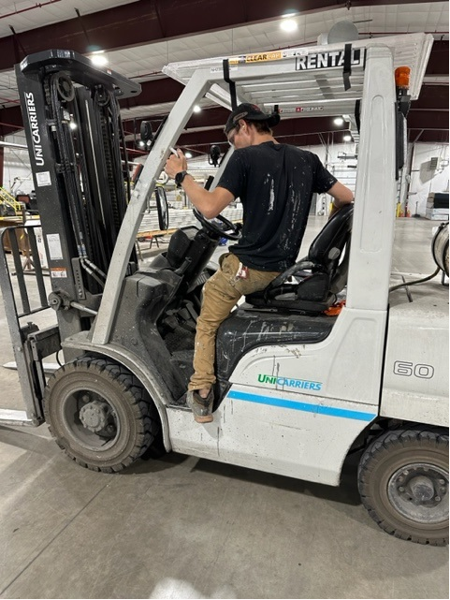
What is unsafe in this picture?

Slide 3



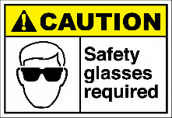


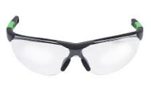
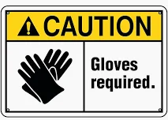

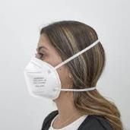
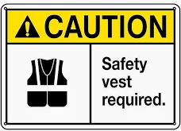

PPE – The last line of defense to keep you safe
1.
2.
3.
Hearing protection – plugs or muffs
4.
5.
6.
Gloves to handle product, paint, propane
Voluntary Respiratory Program
High Visibility Tops

Slide 4

Hearing Conservation Program

Slide 5
Hearing Conservation Program
Level of noise in most areas exceed the threshold of 82.1 dba for 12 hours of exposure OR 85 dba for 8 hours of exposure.
Noise exposure requires employees to have a baseline and annual audiograms to check hearing.
Noise exposure requires employees to use hearing protection, such as ear plugs or earmuffs.
LP will provide hearing protection – either ear plugs or earmuffs

Slide 6


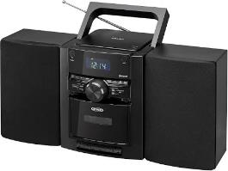
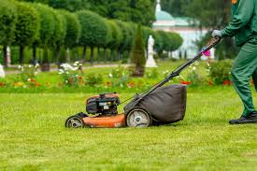

Loud noises – not just at work
Concerts
Ear Buds
Home and Car Stereos
Power Equipment
Range
Protect your hearing away from work!

Slide 7
Effects of noise
Causes hearing loss
Amount of damage depends upon intensity of the noise and duration
Noise induced hearing loss can be temporary or permanent
Prolonged exposure generally causes permanent damage

Slide 8


Effects of noise
Noise can cause irritability
Inability to hear important instructions
High blood pressure, ulcers, headaches
Sleeping disorders

Slide 9
Hearing protection makes common sense
You have the most to lose if you suffer hearing loss
You are ultimately responsible for your hearing
Make sure hearing protection fits properly

Slide 10


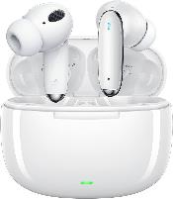
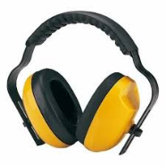

Hearing protection LP Policy
Hearing protection such as ear plugs or earmuffs must be worn when in production areas.
Ear buds are not allowed in production areas
Make sure hearing protection fits properly
See your supervisor or manager if you need help

Slide 11
Questions about Hearing Conservation?

Slide 12


Stormwater Pollution Prevention Plan Training for
LP Green Bay
Prepared by TRC
1429 Rock Quarry Road, Suite 100
Raleigh, NC 27610

Slide 13

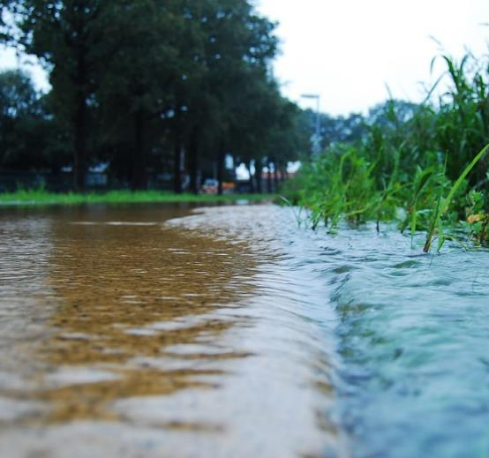
What is Stormwater?
Water from rain or snowmelt
Does not immediately infiltrate into the ground
Flows over or through natural or man-made storage or conveyance systems
Results in increased surface runoff
Picks up industrial pollutants
Discharges into nearby waterbodies or storm water sewer systems

Slide 14

Stormwater Regulatory Background
Clean Water Act (CWA) 1972
Gave EPA authority to implement pollution control programs, such as the National Pollutant Discharge Elimination System or NPDES program
EPA delegated authority to the individual states which issue discharge permits that require facilities to develop a Stormwater Pollution Prevention Plan (SWPPP)

Slide 15
Stormwater Permit Requirements
PERMIT EFFECTIVE MARCH 2023
Facilities covered by a stormwater general permit are required to:
  Implement a Stormwater Pollution Prevention Plan (SWPPP)
  Implement effluent limits to minimize the discharge of pollutants
  Conduct regular inspections of the Facility
  Perform stormwater monitoring
  Report to the state regulatory agency, if required

Slide 16
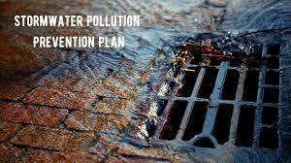
Stormwater Pollution Prevention Plan (SWPPP)​
The purpose of a SWPPP is to minimize stormwater contaminants that flow into surface waters​
Implementation of a SWPPP is required by facility stormwater permit
  Establish a Pollution Prevention Team​
  Describes ways to minimize the impact of industrial activities on water bodies​
  Includes inspections, testing, and reporting requirements​

Slide 17
Elements of SWPPP
Pollution Prevention Team Responsibilities
Facility Description
Identification of Potential Stormwater Contaminants
Stormwater Management Controls
Inspections and Reviews
Amendments and Changes
Records

Slide 18
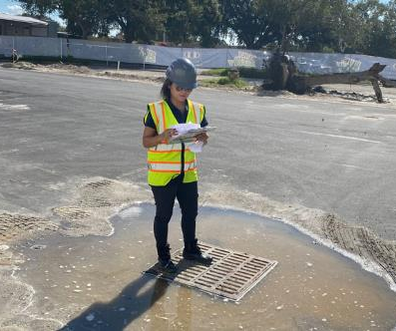
Plant Personnel SWPPP Responsibilities​
Attend training​
Know where the SWPPP is kept​ - EHS Team
Support spill prevention and response​
Implement operational Best Management Practices (BMPs) during daily activities​
Identify improper BMP implementation during daily activities​
Notify coordinator – EHS Team

Slide 19
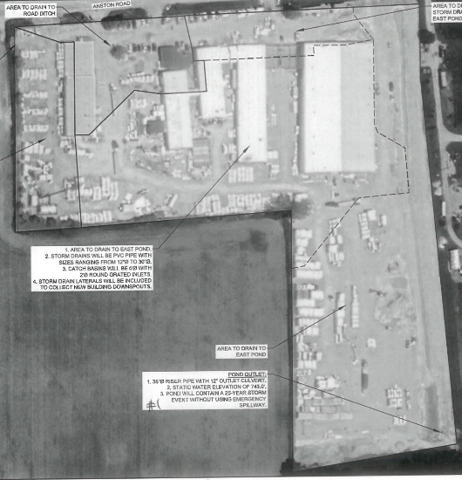

LP GB Stormwater Collection Area
Outfalls to be safely accessible by staff to perform the required monitoring and inspections.
2 Outfalls – one at each corner of the site.
Stormwater runs through the retention pond, which acts as a filter, before leaving the property.
This is standard for commercial, industrial, and residential properties.

Slide 20
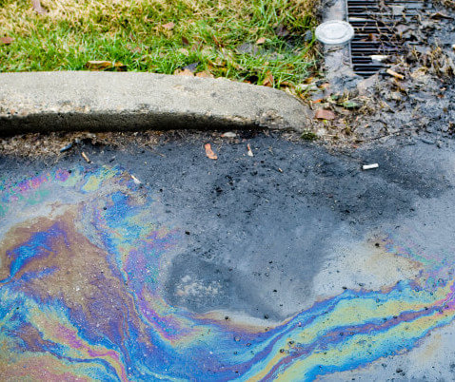
Major Sources of Contaminants in Stormwater
Loading and Unloading Operations
Aboveground Storage Tanks
Exposed Storage (Outdoors or Open to Runoff)
Exposed Process Activities and Mechanical Equipment
Dust or Particulate Generating Processes
Waste Management

Slide 21
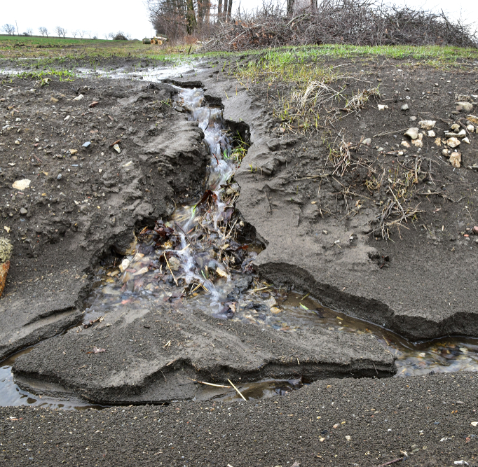
Sediment and Erosion Control​
To prevent erosion, provide soil cover and vegetation in areas that are not disturbed during regular operation.
If erosion is noticed:
  Determine if the stormwater can be routed to an existing structural stormwater avenue
  Install additional controls, if needed.
  Use stone armoring or other manufactured products as needed to stabilize drainage ways.

Slide 22
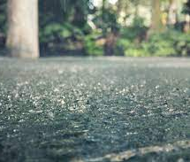
Minimize Exposure
Conduct maintenance indoors.​
Capture and dispose of waste fluids using drip pans or other containment.​
Store drums and other small containers indoors.​​
Minimize chemical exposure outside of facility
Minimize exposure of raw materials and final product
All of LP product stored outside is wrapped

Slide 23
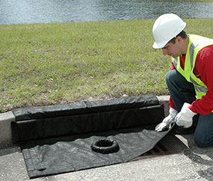
Spill Prevention and Response
Respond to spills and leaks immediately.​
Inspect potential spill areas for spills and leaks during daily activities. ​
Implement Spill Prevention
Utilize secondary containment where needed
Maintain spill kit and supplies. ​

Slide 24
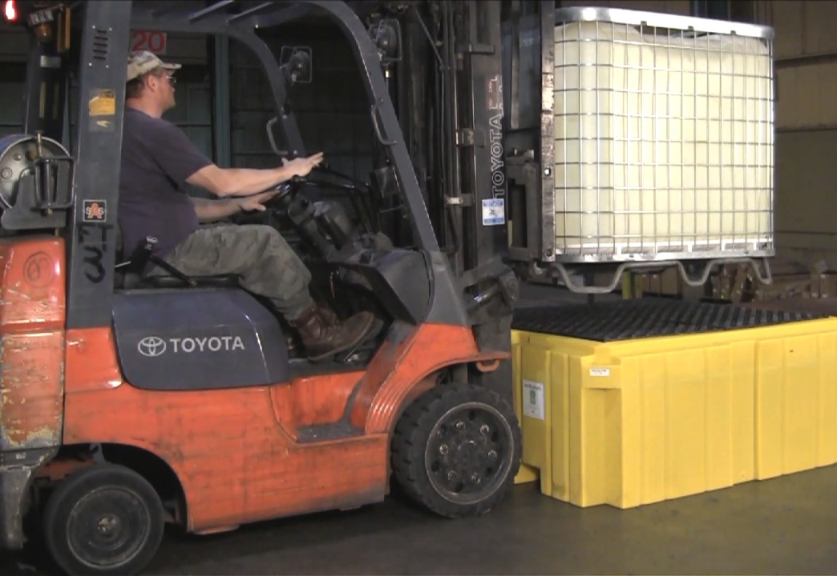
Material Management
All oil, fuel and chemicals should be transported and stored in closed containers
Materials being transported across site should go directly to the intended destination with no additional stops
If needed, material transfer activities should follow procedures to prevent spills or contamination of stormwater

Slide 25
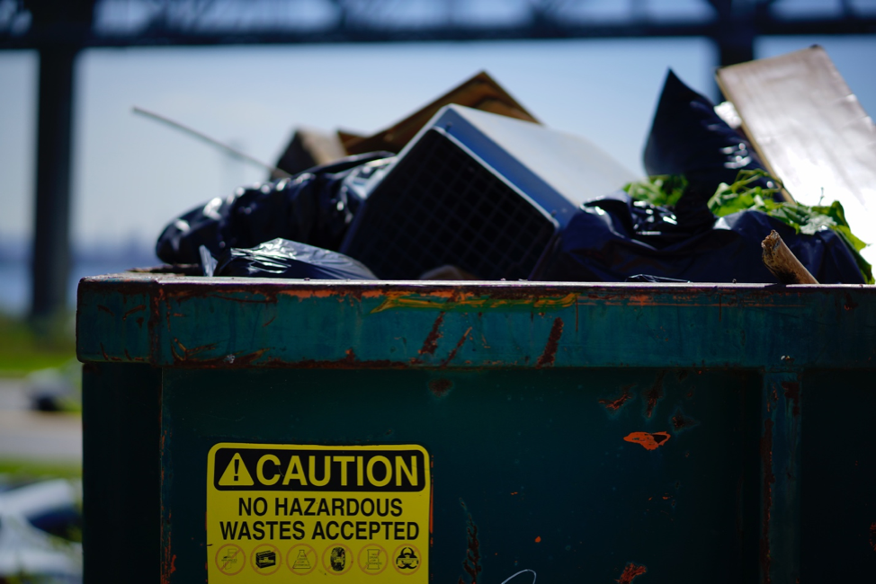
Good Housekeeping
Storage and work areas kept clean and organized.​
Containers clearly labeled. ​
Wastes are picked up and disposed of on a regular basis. ​
Lids and covers are kept on buckets, containers and dumpsters. ​
Drums and other containers stored under cover when not in use.

Slide 26
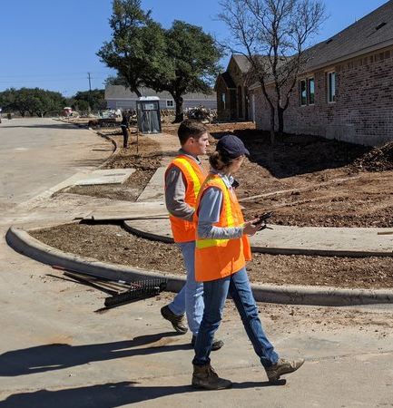
Inspections
1. Quarterly Routine Facility Inspections
  No analytical tests are required
  At least once per year the routine facility inspection will be conducted during a period when a stormwater discharge is occurring.
2. Quarterly Visual Inspection of Stormwater Discharge
  Samples should be collected within the first 30 minutes of an actual discharge from a storm event
3. Annual Comprehensive Site Compliance Inspection/Evaluation
  Review of the entire site to verified current controls in the SWPPP are working efficiently
  4. Visual Monitoring of Stormwater

Slide 27
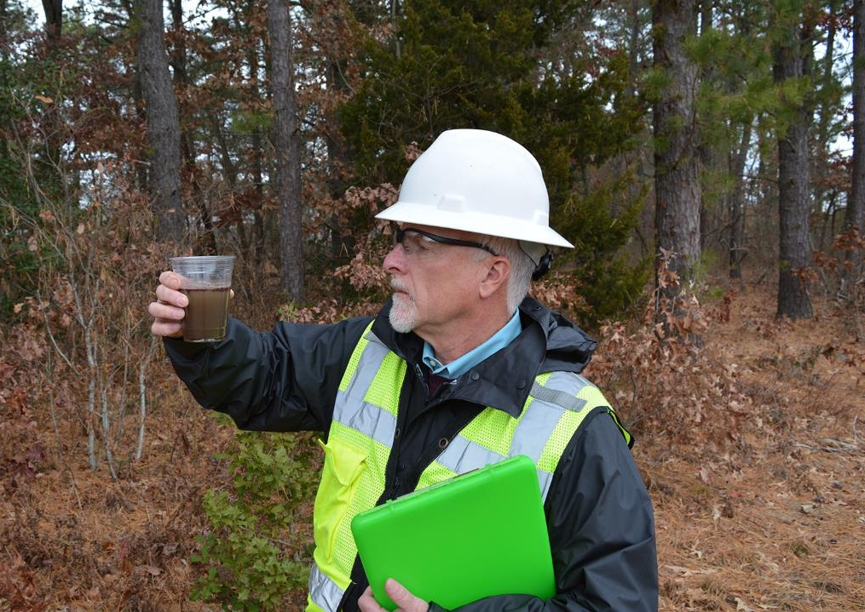
Visual Monitoring of Stormwater
  Quarterly Visual Monitoring must be conducted during a period when a storm water discharge is occurring.

Slide 28
LP GB Reporting
Annual Certification Report (ACR)
  Once per calendar year, fill out and submit the ACR report This report is the primary mechanism for reporting compliance Wisconsin Department of Natural Resources (WDNR).
  The report is required to be submitted online each January.
Spill Reporting - Notification of any spill listed must be reported to the Spills hotline within two hours after discovery.
  Any spill of a hazardous substance or Petroleum must be reported in accordance with SWPP
  Any spill of Petroleum must be reported
  Spill reporting (and notification) requirements to be outlined in the SWPPP

Slide 29
Questions?

